Slide 1

TAKE CARE OF
YOUR TENNIS BODY
A Complete Guide to Tennis Recovery,
Injury Prevention & Long-Term Performance
BY: Federico Barbon

Slide 2

BUILDING HABITS THAT KEEP YOU STRONG, AGILE, AND HEALTHY
Your body is your most important tool in tennis.
Tennis challenges every system: strength, endurance, flexibility, speed, and mental focus.
Professional athletes treat recovery with the same seriousness as training. Recovery IS part of training.
The habits you build now will define how long and how well you play.
This guide covers the science of WHY you need recovery and the practical HOW to do it right.
Everything in this presentation is based on sports science research, not opinion.
TAKE CARE OF YOUR BODY

Slide 3
THE DEMANDS OF TENNIS
1
Understanding what your body goes through every time you step on court
"Tennis is one of the most physically demanding sports. You have to be an all-around athlete — fast, strong, flexible, and resilient."
— Novak Djokovic

Slide 4
THE PHYSICAL DEMANDS OF TENNIS
500+
3-6
NO CLOCK
1000s
Direction changes
per match
Hours of intense
physical activity
Match doesn't end
until someone wins
Repetitive strokes
per session
Tennis has no clock and there are no draws. Unlike soccer or football, it can go on for hours.
Repeated serves, sprints, and lateral movements stress muscles, tendons, and joints in every session.
Hard courts create higher impact forces on knees, ankles, and hips than clay or grass.
Tennis is an asymmetric sport — your dominant arm, shoulder, and side work far harder, creating muscle imbalances over time.
Recovery, stretching, and mobility work are essential to keep your body balanced, strong, and injury-free.
TAKE CARE OF YOUR BODY

Slide 5
WARM-UP SCIENCE
2
Why warming up properly is non-negotiable
"I always warm up the same way. It's part of my routine. If I skip it, my body knows — and my game suffers."
— Maria Sharapova

Slide 6




WHY YOU MUST WARM UP PROPERLY
Raises Heart Rate & Blood Flow
Prevents Muscle Injuries
Warming up increases core body temperature by 1-2°C, which improves muscle elasticity and nerve transmission speed.
Cold muscles are more prone to tears and strains. Research shows dynamic warm-ups reduce injury risk by up to 35%.
Improves Performance
Mental Preparation
Studies show athletes who warm up properly have faster reaction times, more explosive first steps, and better coordination.
A warm-up routine signals your brain it's time to compete. It activates focus, calms nerves, and builds match readiness.
THE RULE: If you're not sweating and breathing heavily, you're not ready to play.
TAKE CARE OF YOUR BODY

Slide 7
BASIC WARM-UP EXAMPLE
1
Run 3 laps around the court — always run first to get the blood flowing
2
IYTWAs with band — 5 of each (25 reps total, hold 2 sec each)
3
High knees, butt kicks, shuffles, carioca
4
Arms: skipping with big arm circles, up/down, open/close
5
10 running drills: A-skips, B-skips, C-skips, D-skips, skip-skip & switch, skip-skip & 1-2, skip-skip & 1-2-3, skipping for height, skipping for distance, broad jumps, straight legs, pogos
6
4 hard sprints — progressive intensity: 80% / 85% / 90% / 100%
7
Juggle for hand-eye coordination
BEFORE MATCHES: ALWAYS include hand-eye coordination drills (reaction drills, side-to-side tennis ball catches, catching + volley footwork). These activate focus, calm nerves, and build match readiness.
TAKE CARE OF YOUR BODY

Slide 8
YOUR WARM-UP NEEDS TO BE INTENSE
A lazy warm-up = a cold body = higher injury risk + worse performance.
Your warm-up should be PROGRESSIVE and finish at HIGH INTENSITY.
Progressive means building up
Start light, but by the end of the warm-up you should be sweating, breathing hard, and your muscles should feel warm and ready to explode. If you're still cold, you're not done.
Going through the motions is not warming up
Walking around the court, doing lazy arm swings, and chatting with friends is NOT a warm-up. Treat it like the rest of your training — with focus and effort.
A great warm-up sets the tone for the whole session
Players who warm up intensely perform better from the very first ball. Your body responds faster, your movements are sharper, and your mind is locked in.
TAKE CARE OF YOUR BODY

Slide 9
WHAT HAPPENS INSIDE YOUR BODY
3
The science of muscle repair and why recovery matters
"I spend as much time on recovery as I do on practice. My body needs it to keep performing at the highest level."
— Rafael Nadal

Slide 10

WHAT HAPPENS DURING EXERCISE
YOU TRAIN
MICRO-TEARS
INFLAMMATION
REPAIR
Muscles contract
repeatedly under
load and stress
Tiny tears form in
muscle fibers —
this is normal
Your body sends
blood and nutrients
to the damaged area
With proper recovery
and nutrition, fibers
rebuild stronger
SORENESS = PROGRESS (when managed correctly)
Delayed Onset Muscle Soreness (DOMS) is your body's repair process at work. It typically peaks 24-48 hours after intense activity. Recovery tools like stretching, foam rolling, massage guns, light cardio, and ice baths help speed up this process by boosting blood flow and delivering nutrients to damaged tissue.
TAKE CARE OF YOUR BODY

Slide 11
WHAT HAPPENS WHEN YOU SKIP RECOVERY
SKIP RECOVERY
RECOVER PROPERLY
Muscles stay tight and shortened after every session — this tightness accumulates day after day
Tight muscles lose flexibility and range of motion, making them much more likely to PULL or TEAR during a sprint, serve, or sudden movement
A pulled muscle can keep you off the court for weeks or even months
Accumulated tightness leads to chronic pain in shoulders, elbows, knees, and back
Burnout, loss of motivation, and a shorter athletic career
Reduced soreness
Flexible, responsive muscles ready for action
Faster reaction time and explosive first steps
Muscles rebuild stronger after each session
Balanced body, fewer imbalances and pain
Sustained energy and love for the game
Long, healthy athletic career
TAKE CARE OF YOUR BODY

Slide 12
FULL-BODY STRETCHING ROUTINE
4
Stretches for post-training recovery
It just takes 18min/day
"The key is not the will to win. Everybody has that. It is the will to prepare to win that is important."
— Novak Djokovic

Slide 13






THE SCIENCE OF STRETCHING
Why Stretch?
Stretching keeps your muscles long and flexible. Without it, muscles shorten and tighten — and tight muscles are the #1 cause of injuries. Stretching also reduces soreness and helps you move better on court.
Hold: 30-60 Seconds
Repeat: 2 Sets
When: EVERY DAY
Hold each stretch for 30-60 seconds. This is the sweet spot for flexibility gains.
2 sets per muscle group. Consistency beats intensity.
Stretch after training AND on days off. Daily = lasting flexibility.
Results Take 4+ Weeks
Push Deeper — Be Uncomfortable
Keep going — consistent stretching for 4+ weeks produces real, lasting improvements in range of motion.
If you're comfortable, you're not gaining flexibility. Each session, reach a little deeper. That's how muscles lengthen.
Evidence: Warneke et al. 2025 Delphi consensus; Konrad et al. 2022 meta-analysis
TAKE CARE OF YOUR BODY

Slide 14
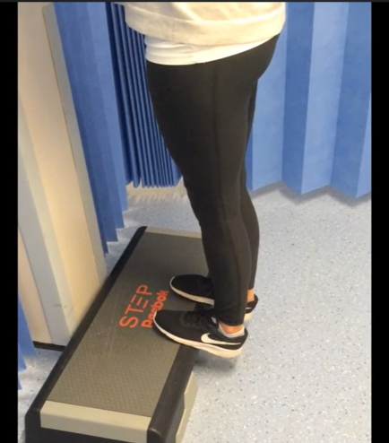
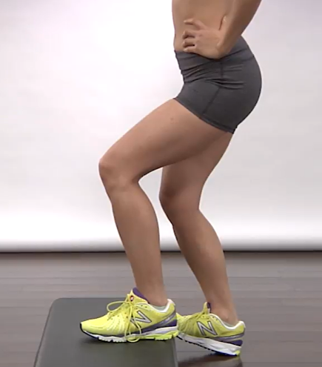
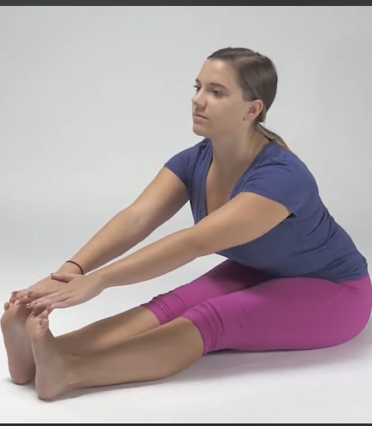
STRETCHING ROUTINE: LOWER BODY
It just takes 18min/day
Hold 30s | 2 sets each
Calves (Soleus)
Calves (Gastrocnemius)
Hamstrings
Heels Hanging Off Step
Heels Hanging — Bent Knee
Sitting Toe Touch
Add image here
Add image here
Add image here
TAKE CARE OF YOUR BODY

Slide 15
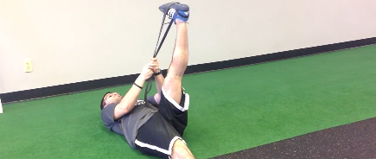
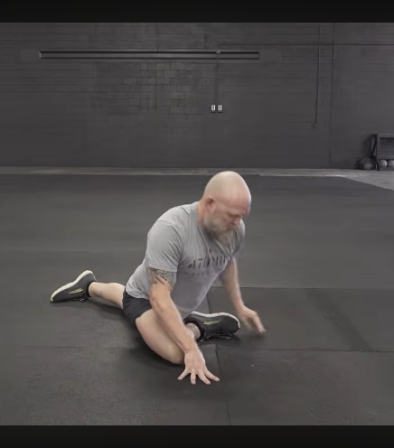
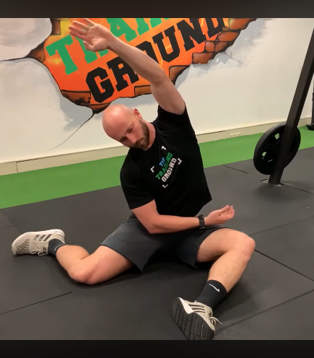
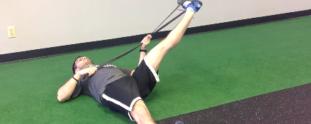
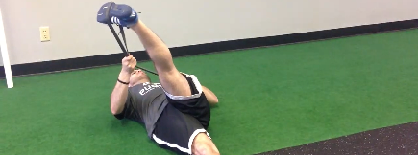
STRETCHING ROUTINE: LOWER BODY
It just takes 18min/day
Hold 30s | 2 sets each
Hamstrings (3 Angles)
Glutes
Quadratus Lumborum (QL)
Band-Assisted Pull (30s each angle)
Pigeon Stretch
Knees at 90°, Lean Sideways
Add image here
Add image here
TAKE CARE OF YOUR BODY

Slide 16
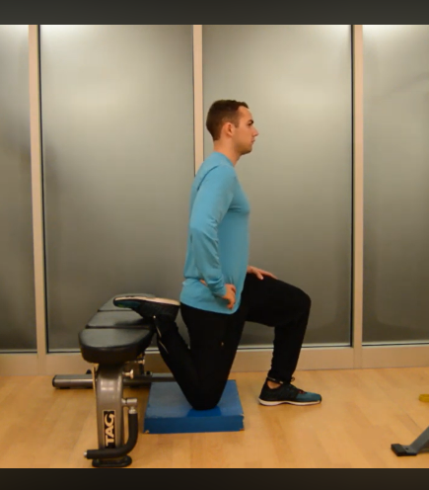
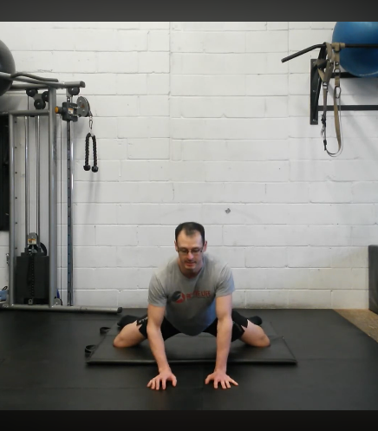
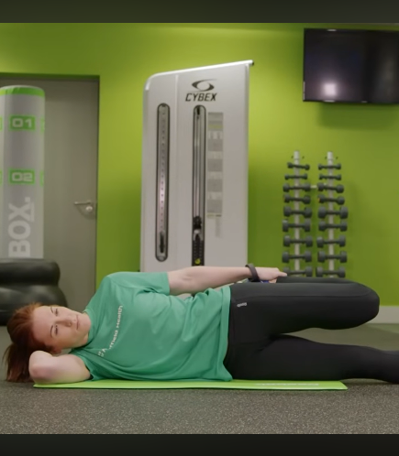
STRETCHING ROUTINE: LOWER BODY
It just takes 18min/day
Hold 30s | 2 sets each
Hip Flexors
Hip Adductors
Quadriceps
Lunge on Bench
Frog Groin Stretch
Side-Lying Quad Pull
Add image here
Add image here
Add image here
TAKE CARE OF YOUR BODY

Slide 17
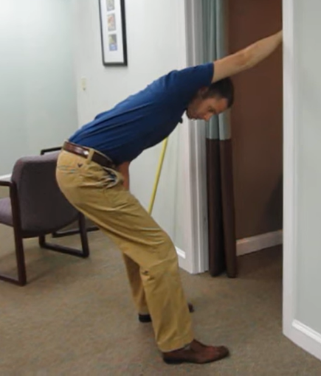
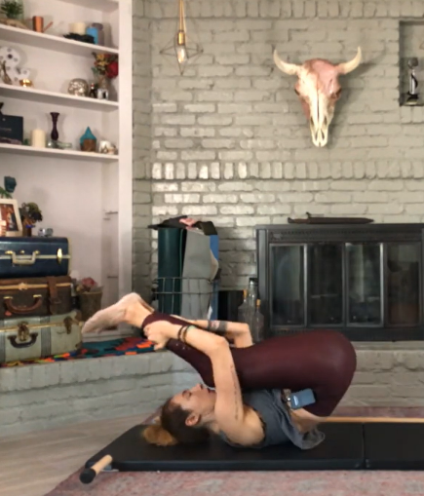
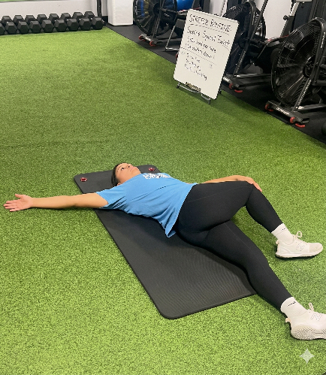
STRETCHING ROUTINE: CORE & BACK
It just takes 18min/day
Hold 30s | 2 sets each
Latissimus Dorsi
Low Back
Low Back
Door Frame Grab & Lean
Backward Roll
Spinal Twist (Supine)
Add image here
Add image here
Add image here
TAKE CARE OF YOUR BODY

Slide 18
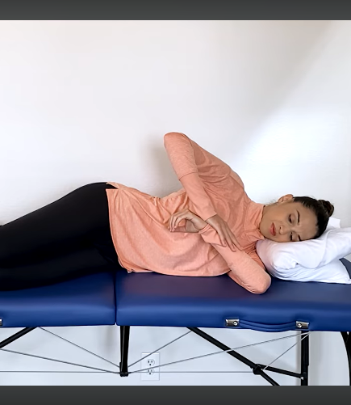
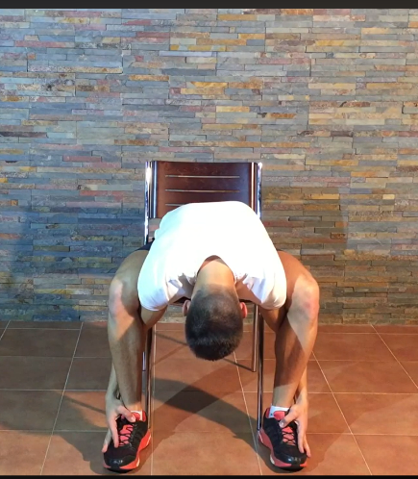
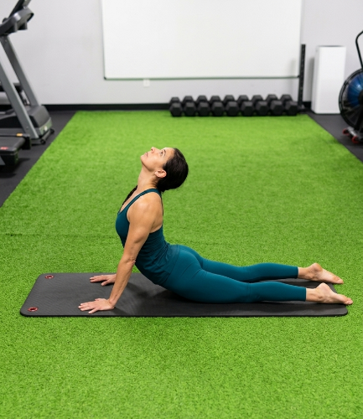
STRETCHING ROUTINE: CORE & BACK
It just takes 18min/day
Hold 30s | 2 sets each
Rotator Cuff
Erector Spinae
Abdomen
Sleeper Stretch (Side-Lying push forearm down)
Seated Chair Grab & Round
Cobra Stretch
Add image here
Add image here
Add image here
TAKE CARE OF YOUR BODY

Slide 19
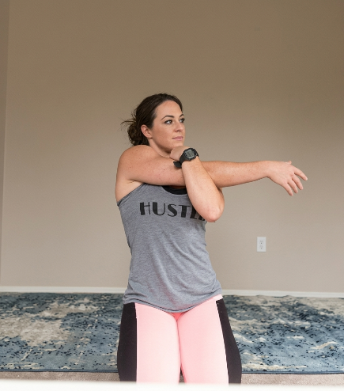
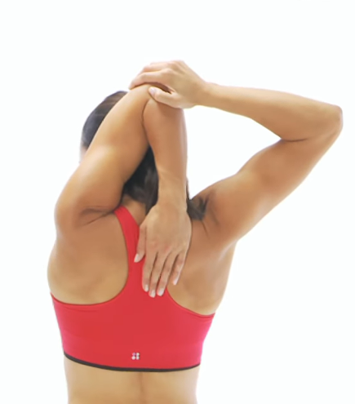
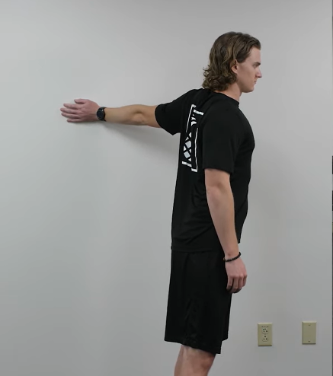
STRETCHING ROUTINE: UPPER BODY
It just takes 18min/day
Hold 30s | 2 sets each
Deltoids (Shoulders)
Triceps
Biceps
Cross-Arm Stretch
Behind-Neck Stretch
Straight Arm Against Wall
Add image here
Add image here
Add image here
TAKE CARE OF YOUR BODY

Slide 20
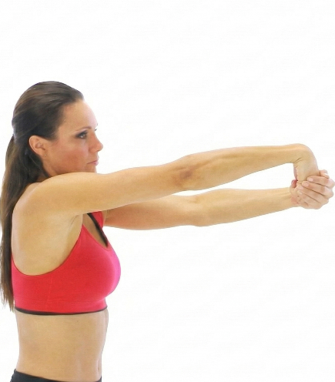
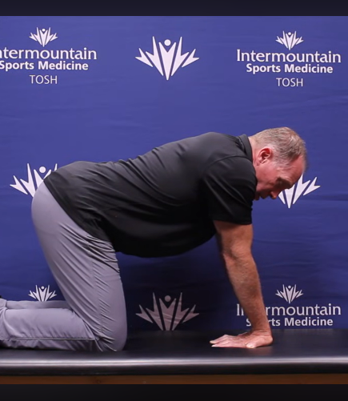
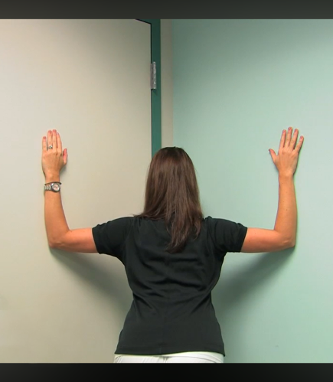
STRETCHING ROUTINE: UPPER BODY
It just takes 18min/day
Hold 30s | 2 sets each
Wrist Extensors
Wrist Flexors
Pectoralis Major (Chest)
Fist Pull Down
Tabletop — Fingers Toward You
Bent Arms in Wall Corner
Add image here
Add image here
Add image here
TAKE CARE OF YOUR BODY

Slide 21
INJURY PREVENTION
5
Targeted mobility exercises for common tennis injuries
"I believe in taking care of my body. It's one of the keys to longevity in this sport."
— Serena Williams

Slide 22
COMMON TENNIS INJURIES & PREVENTION
Do these if you’re especially sore in any of these areas. If pain exceeds 5/10, you should see a professional.
Mobility routine: Approximately 15 minutes total each routine
ELBOW
SHOULDER
Tennis/Golfer's Elbow
Rotator Cuff & Impingement
KNEE & ANKLE
LOW BACK
Patellar & Ligament Issues / Sprains
Pain & Disc Issues
Each injury area has specific mobility exercises detailed on the following slides.
TAKE CARE OF YOUR BODY

Slide 23
ELBOW & SHOULDER PREVENTION
ELBOW — Tennis/Golfer's Elbow
EXERCISE | PROTOCOL | HOW TO PERFORM
Eccentric Wrist Curls (Flexion) | 3 × 15 reps
Eccentric Wrist Curls (Extension) | 3 × 15 reps
Grip Strengthening (Tennis Ball) | 3 × 15 squeezes
Wrist Flexor Stretch | 30 sec × 3
Wrist Extensor Stretch | 30 sec × 3
SHOULDER — Rotator Cuff & Stability
EXERCISE | PROTOCOL | HOW TO PERFORM
Band External Rotations | 3 × 15 reps
YTW Raises | 3 × 12 reps each
Wall Corner Pec Stretch | 30 sec × 3
Tennis one-sided repetition builds up — these exercises keep your elbow and shoulder balanced, strong, and injury-free
TAKE CARE OF YOUR BODY

Slide 24
KNEE, ANKLE & LOW BACK PREVENTION
KNEE & ANKLE
EXERCISE | PROTOCOL | HOW TO PERFORM
Eccentric Single Leg Squats | 3 × 12 each side
Glute Bridges | 3 × 15 reps
Banded Ankle Dorsiflexion | 2 × 10 each side
LOW BACK
EXERCISE | PROTOCOL | HOW TO PERFORM
Cat-Cow | 2 × 10 reps
Dead Bug | 3 × 10 each side
Hip Flexor Stretch (on Bench) | 30 sec × 3 each
Strong knees, stable ankles, and a healthy lower back are your foundation for every sprint, stop, and direction change.
TAKE CARE OF YOUR BODY

Slide 25
RECOVERY TOOLS
6
Evidence-based tools you can use at home
"You have to believe in the long-term plan. Recovery is what separates good players from great players."
— Andy Murray

Slide 26
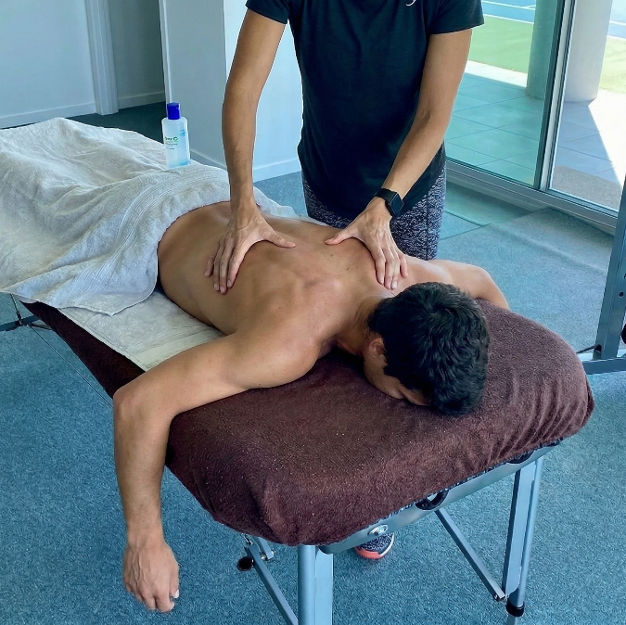
How would you feel
if you got a massage
every day after
practice?
Add player
massage image
here
That's exactly what a foam roller
and massage gun can do for you.
Every day. At home. For free.
TAKE CARE OF YOUR BODY

Slide 27




YOUR RECOVERY TOOLKIT
All of these tools share one primary mechanism: they increase blood flow to damaged tissue, which speeds up nutrient delivery and waste removal for faster recovery.
MASSAGE GUN
FOAM ROLLER
Duration: 1-2 min per muscle
OR
Duration: 90-120 sec per muscle
ICE BATH / COLD SWIMMING POOL
LIGHT CARDIO
14 and older -Duration: 10-15 min at 50-59°F (10-15°C)
Under 14 yrs old -Duration: 10-15 min at 64–72°F (18–22°C)
Light jogging, swimming, or cycling
Duration: 10-15 min post-match
TAKE CARE OF YOUR BODY

Slide 28
LIGHT CARDIO: Active Recovery
Research: Active recovery is more effective than passive rest for clearing metabolic waste (soreness) and restoring performance (Ortiz et al. 2018 systematic review).
ACTIVE RECOVERY GUIDELINES
After a match/practice: 10-15 minutes
On an off day: 20-30 minutes
Easy effort — light jogging, swimming, or cycling
Try a different activity than tennis to give sport-specific muscles a break
You will feel BETTER than when you started
Active recovery is the most underrated recovery tool. Simply moving your body at low intensity is one of the best things you can do to speed up recovery.
TAKE CARE OF YOUR BODY

Slide 29
FOAM ROLLER: How to Use It Right
Research: A minimum of 90 seconds per muscle group is needed to reduce soreness (Hughes et al. 2019). A 2024 study confirmed that 120+ seconds is optimal for recovery.
SETTING | RECOMMENDATION
Duration per muscle | 90-120 seconds minimum for soreness relief; 2 minutes for optimal results
Total session time | 10-15 minutes (covering all major muscle groups)
Rolling speed | Slow and controlled — about 1 inch per second
Pressure | Moderate. It should feel like a deep massage, not painful agony
Frequency | 3-5 times per week for lasting flexibility improvements
When to use | After training (recovery) or before training (as part of warm-up with dynamic stretches)
Trigger points | When you find a sore spot, pause and hold pressure for 20-30 seconds
AVOID rolling directly over the lower back, knees, or neck.
TAKE CARE OF YOUR BODY

Slide 30
FOAM ROLLER: Target Areas for Tennis
Total session: 10-15 minutes
Quadriceps
90-120 sec per leg
Hamstrings
90-120 sec per leg
Face down, roll from hip to just above the knee. Turn slightly to hit inner/outer quad.
Sit on the roller, roll from glute to just above the knee. Cross one leg over for more pressure.
IT Band (Outer Thigh)
90-120 sec per side
Calves
90-120 sec per leg
Lie on your side, roll from hip to just above the knee. This one hurts — go slow.
Sit with calf on roller. Roll from ankle to below the knee. Cross legs for more pressure.
Glutes
90-120 sec per side
Upper Back
90-120 sec
Sit on roller, cross one ankle over opposite knee, lean into the hip. Great for hip tightness.
Lie face up, roller behind upper back. Arms crossed over chest. Roll between shoulder blades and mid-back.
Lats (Side of Back)
60-90 sec per side
Hip Flexors / TFL
60-90 sec per side
Lie on your side with roller under armpit area. Roll from armpit to mid-rib cage.
Face down, roller at front of hip. Gentle pressure — this area is sensitive.
TAKE CARE OF YOUR BODY

Slide 31
MASSAGE GUN: How to Use It Right
Research: A 2023 systematic review found percussive therapy reduces DOMS by 25-35% at 24 and 48 hours when used within 2 hours of exercise.
SETTING | RECOMMENDATION
Duration per muscle group | 1-2 minutes for recovery; up to 2-3 minutes for mobility work
Total session time | 10-15 minutes maximum
Speed setting (recovery) | Low to medium (below 2400 RPM)
Speed setting (flexibility) | Medium to high (above 2400 RPM) for max 2 min per muscle
Pressure | Let the device do the work — no extra pressing needed
Movement | Move slowly along the muscle belly, not on bones or joints
Pre-workout use | 30-60 seconds per muscle at medium speed for activation
Timing (post-exercise) | Within 2 hours of finishing for best results
TAKE CARE OF YOUR BODY

Slide 32
MASSAGE GUN: Target Areas for Tennis
Total session: 10-15 minutes
Quadriceps
1-2 min per leg
Calves
1-2 min per leg
Move from hip to just above the knee. Use flat or ball head.
Cover inner, outer, and back of calf. Avoid the shin bone.
Hamstrings
1-2 min per leg
Forearms
60-90 sec per arm
From just below the glute to above the knee. Slow movements.
Critical for tennis players. Cover both flexors and extensors.
Shoulders / Upper Traps
60-90 sec each
Glutes
1-2 min per side
Focus on the muscle belly. Avoid the collar bone and spine.
Use the ball head. Can use while seated for deeper pressure.
Upper Back (Lats)
60-90 sec per side
Feet (Plantar Fascia)
60 sec per foot
Run along the lat muscle. Avoid the spine directly.
Use the bullet tip on the sole. Gentle pressure only.
TAKE CARE OF YOUR BODY

Slide 33




ICE BATH (Cold Water Immersion)
Research: A 2025 network meta-analysis in Frontiers in Physiology found 10-15 min at 10-15°C (50-59°F) was the most studied and effective protocol for reducing soreness and muscle damage markers in adults.
Temperature: 50-59°F (10-15°C)
Duration: 10-15 Minutes
A cool bath/swimming pool works well
True Ice bath: A standard bag of ice from a gas station (~10 lbs) is enough to bring a full tub down to this range
Beyond 15 min, benefits diminish and risks increase.
Best For: After Matches
Caution: If you’re under 14 years old
Most beneficial after competition or intense training. Use within 30-60 minutes of finishing exercise.
True ice baths (10–15°C) are not recommended for children.
A cool bath/swimming pool is safer and sufficient for kid’s recovery
SAFETY: Exit immediately if you feel dizzy, confused, or experience uncontrollable shivering. Young athletes should always have adult supervision.
TAKE CARE OF YOUR BODY

Slide 34
SAMPLE RECOVERY ROUTINES
7
Putting it all together into practical protocols
"The work you put in off the court — the stretching, the recovery, the discipline — is what allows you to perform."
— Roger Federer

Slide 35
POST-MATCH RECOVERY ROUTINE
~50 MINUTES
10 min
Light Cardio Cool-Down
Easy jog, walk, or bike ride right after your last match of the day. This is your most important first step.
10 min
Foam Rolling or Massage Gun
Foam roll: 90-120 sec per muscle (quads, hamstrings, calves, glutes, upper back). OR Massage gun: 1-2 min per muscle group at low-medium speed.
20 min
Full Stretching Routine
Complete the full-body static stretching routine from Section 4. Hold each stretch 30s, 2 sets. Focus extra time on your dominant arm and any sore areas.
10 min
Ice Bath / Cool bath
Best after competition matches
TAKE CARE OF YOUR BODY

Slide 36
REST DAY RECOVERY ROUTINE
~60 MINUTES
10 min
Light Cardio / Active Recovery
Easy swimming, cycling, or jogging. Keep intensity low. Choose a different activity than tennis.
15 min
Foam Rolling Session
Foam roll: 90-120 sec per muscle (quads, hamstrings, calves, glutes, upper back). OR Massage gun: 1-2 min per muscle group at low-medium speed.
15 min
Mobility & Injury Prevention
Complete the injury prevention exercises from Section 5. ~15 minutes.
20 min
Breathing & Mindfulness
Full Stretching Routine
5-10 minutes of deep breathing or light meditation. This helps activate your parasympathetic nervous system (rest and digest mode), reducing cortisol and improving sleep quality.
Complete the full-body static stretching routine from Section 4. Hold each stretch 30s x2 sets. Focus extra time on your dominant arm and any sore areas.
TAKE CARE OF YOUR BODY

Slide 37
NUTRITION FOR TENNIS
8
Fuel your body like a professional athlete
"A change in my diet allowed my body to perform the way it was meant to. With that change, I felt much stronger as a tennis player."
— Novak Djokovic

Slide 38

EAT REAL FOOD
The #1 nutrition rule: eat food that comes from nature, not from a factory.
What is "real food"?
Fruits, vegetables, rice, chicken, fish, eggs, nuts, beans, oats — food that looks like what it actually is. If your grandmother would recognize it as food, it's probably real food.
What is "processed food"?
Chips, candy, soda, fast food, frozen meals, sugary cereals — food that comes in a package with a long list of ingredients you can't pronounce.
The simple rule:
Look at the ingredients list on the package. The fewer ingredients, the better. If it has 3-5 ingredients, it's probably okay. If it has 20+ ingredients with names you don't recognize — skip it.
Real food always comes first. Supplements are just that — supplements, not replacements.
TAKE CARE OF YOUR BODY

Slide 39
NUTRITION: The Foundation of Performance
CARBOHYDRATES
PROTEIN
HEALTHY FATS
Your Fuel
Your Repair Kit
Your Protector
Carbs are stored as energy in your muscles. They are your main fuel during tennis. Without enough carbs, you'll run out of energy mid-match.
Good sources: Rice, pasta, oats, bread, potatoes, bananas, fruits.
Protein rebuilds the muscle fibers damaged during training. Without enough protein, recovery is slower.
Good sources: Chicken, fish, eggs, dairy, beans, lentils, tofu.
GOOD fats: avocado, nuts, olive oil, salmon, seeds. These reduce inflammation, protect joints, and help absorb vitamins.
BAD fats: fried food, fast food, chips, pastries, processed snacks. These increase inflammation and slow recovery.
6-10 g per kg body weight daily
~1.6 g per kg body weight daily
Choose natural fats, avoid fried/processed
TAKE CARE OF YOUR BODY

Slide 40
HOW MUCH DO YOU NEED? (Daily Targets)
Based on sports science: Carbs 7g/kg, Protein 1.6g/kg, Fats 1g/kg per day for training tennis players
YOUR WEIGHT | DAILY CARBS | DAILY PROTEIN | DAILY FATS
35-45 kg (77-99 lb) | 245-315 g | 56-72 g | 35-45 g
45-55 kg (99-121 lb) | 315-385 g | 72-88 g | 45-55 g
55-65 kg (121-143 lb) | 385-455 g | 88-104 g | 55-65 g
65-75 kg (143-165 lb) | 455-525 g | 104-120 g | 65-75 g
75-85 kg (165-187 lb) | 525-595 g | 120-136 g | 75-85 g
These numbers might look confusing — the next slides show you exactly what this looks like in REAL FOOD.
Note: These are guidelines for training days. On rest days, reduce carbs slightly. If you play multiple matches, eat more carbs. Everyone is different — listen to your body and adjust.
TAKE CARE OF YOUR BODY
Nutrition Examples

Slide 41
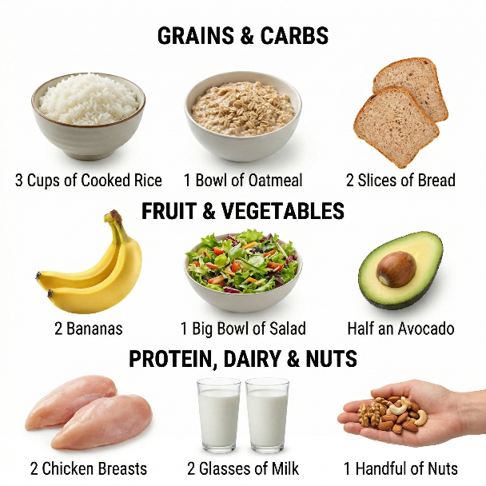
IF YOU WEIGH 35-45 KG (77-99 LB)
Here's what a FULL DAY of eating looks like for you:
2 chicken breasts (or fish/meat equivalent)
3 cups of cooked rice or pasta
1 bowl of oatmeal
2 bananas or pieces of fruit
1 big bowl of salad or cooked veggies
2 glasses of milk
1 handful of nuts
2 slices of bread or toast
1 tablespoon of olive oil or half an avocado
Add plate
image here
TAKE CARE OF YOUR BODY

Slide 42
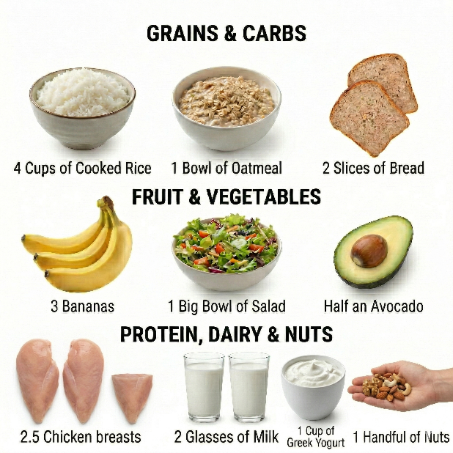
IF YOU WEIGH 45-55 KG (99-121 LB)
Here's what a FULL DAY of eating looks like for you:
2.5 chicken breasts (or fish/meat equivalent)
4 cups of cooked rice or pasta
1 bowl of oatmeal
3 bananas or pieces of fruit
1 big bowl of salad or cooked veggies
2 glasses of milk
1 cup of Greek yogurt
1 handful of nuts
2 slices of bread or toast
1 tablespoon of olive oil or half an avocado
Add plate
image here
TAKE CARE OF YOUR BODY

Slide 43
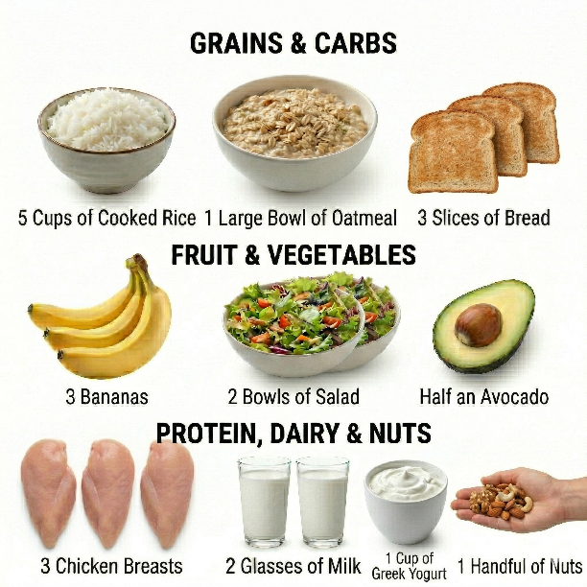
IF YOU WEIGH 55-65 KG (121-143 LB)
Here's what a full day of eating looks like for you:
3 chicken breasts (or fish/meat equivalent)
5 cups of cooked rice or pasta
1 large bowl of oatmeal
3 bananas or pieces of fruit
2 bowls of salad or cooked veggies
2 glasses of milk
1 cup of Greek yogurt
1 handful of nuts
3 slices of bread or toast
1 tablespoon of olive oil or half an avocado
Add plate
image here
TAKE CARE OF YOUR BODY

Slide 44
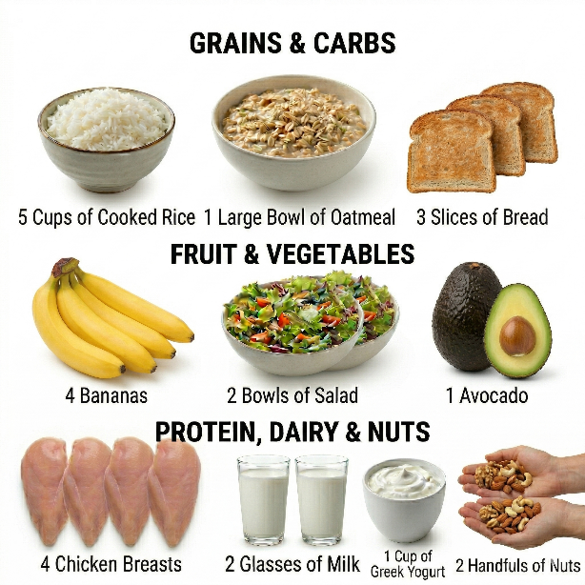
IF YOU WEIGH 65-75 KG (143-165 LB)
Here's what a full day of eating looks like for you:
4 chicken breasts (or fish/meat equivalent)
5 cups of cooked rice or pasta
1 large bowl of oatmeal
4 bananas or pieces of fruit
2 bowls of salad or cooked veggies
2 glasses of milk
1 cup of Greek yogurt
2 handfuls of nuts
3 slices of bread or toast
2 tablespoons of olive oil or 1 avocado
Add plate
image here
TAKE CARE OF YOUR BODY

Slide 45
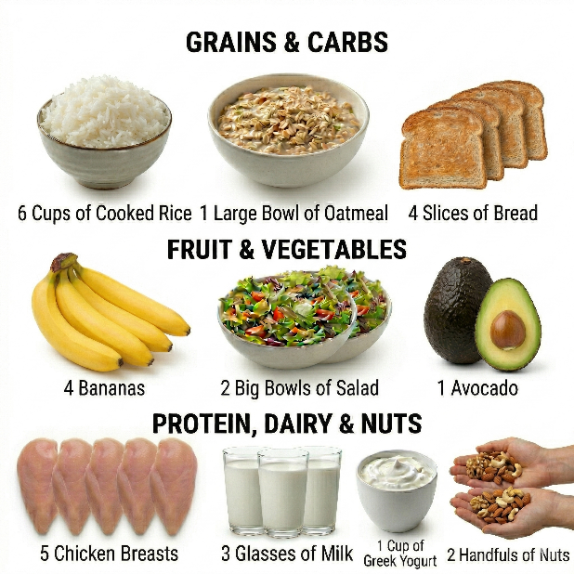
IF YOU WEIGH 75-85 KG (165-187 LB)
Here's what a full day of eating looks like for you:
5 chicken breasts (or fish/meat equivalent)
6 cups of cooked rice or pasta
1 large bowl of oatmeal
4 bananas or pieces of fruit
2 big bowls of salad or cooked veggies
3 glasses of milk
1 cup of Greek yogurt
2 handfuls of nuts
4 slices of bread or toast
2 tablespoons of olive oil or 1 avocado
Add plate
image here
TAKE CARE OF YOUR BODY

Slide 46
KEEP IN MIND
You don't have to eat all of this in 3 meals
Spread it across the whole day: breakfast, snacks, lunch, pre-practice, post-practice, dinner. Eating smaller amounts more often is easier on your stomach and keeps your energy steady.
These are just examples
You can swap chicken for fish, turkey, eggs, beef, beans, or any other protein source you like. The point is how much protein you need, not which specific food. This applies to the other food examples as well
NOTE
All the previous information given about nutrition and hydration are general guidelines and it is not an individualized meal plan. To obtain further information about specific and individualized food and fluid intakes it is recommended to go to a Sports Dietitian.
TAKE CARE OF YOUR BODY

Slide 47
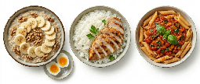
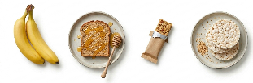
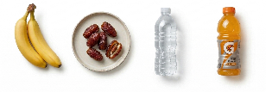
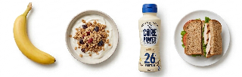

MATCH DAY NUTRITION TIMELINE
3 HRS BEFORE
Complex carbs + moderate protein + low fat. Examples: oatmeal with banana and eggs, rice with chicken, pasta with lean sauce.
Main Meal
60-90 MIN BEFORE
Easy-to-digest carbs: banana, toast with honey, energy bar, rice cake.
Light Snack
DURING MATCH
Every changeover: Water + electrolytes + snacks like dates, bananas (small bites)
Fuel & Hydrate
WITHIN 30 MIN AFTER
Protein + carbs for muscle repair. Examples: protein shake + banana, chicken sandwich, yogurt with granola
Recovery Window
2-3 HRS AFTER THE LAST MATCH OF THE DAY
Balanced plate: lean protein, complex carbs, vegetables, healthy fats. Example: steak with sweet potato and salad, chicken with rice and broccoli
Full Recovery Meal
TAKE CARE OF YOUR BODY

Slide 48

HYDRATION: Drink Water All Day, Every Day
You should NEVER step on court already dehydrated.
Carry a water bottle with you EVERYWHERE
Drink water throughout the entire day — not just during practice. By the time you feel thirsty, you're already dehydrated. Your goal is to arrive at every session already hydrated.
How much? At least 2.5-3 liters (half a gallon to a gallon) per day
That's about 8-10 glasses. More if it's hot or you're sweating a lot. A simple check: your urine should be light yellow, not dark. Dark urine = dehydrated
During matches: Drink water + electrolytes. Drink more if its hot (25°C / 75°F or hotter)
Electrolytes matter!
When you sweat, you lose salt and minerals — not just water. Add electrolytes (sports drinks, tablets, or a pinch of salt) especially in hot weather. Drinking only plain water when you've sweated a lot can actually make you feel worse.
Electrolytes examples: Nuun, Hydralyte, Liquid I.V., Pedialyte
TAKE CARE OF YOUR BODY

Slide 49
SLEEP
9
The most powerful recovery tool you have
"I need my 10 hours of sleep. If I don't get that, I don't feel recovered. Sleep is where the magic happens."
— Roger Federer

Slide 50




SLEEP: Your Body's #1 Recovery Tool
Athletes who sleep less than 8 hours have a 2x HIGHER injury risk
How Much: 8-10 Hours (Ages 10-18)
Sleep = Performance
This is not a suggestion — it's what your growing body needs. Most muscle repair and growth hormone release happens during deep sleep.
Studies show that athletes who get 9+ hours of sleep run faster, react quicker, and make fewer errors. Sleep affects your coordination, focus, and reaction time on court.
Consistent Schedule
Screen Off 30-60 Min Before Bed
Go to bed and wake up at the same time every day — even on weekends. Your body's clock works best with a routine.
Blue light from phones and screens suppresses melatonin (your sleep hormone). Put screens away before bed for deeper, better-quality sleep.
TAKE CARE OF YOUR BODY

Slide 51






PUTTING IT ALL TOGETHER
Everything you've learned in this presentation comes down to a few daily habits:
Stretch every day
This is the most important habit. Daily stretching reduces soreness, prevents tightness from building up, and dramatically lowers your risk of pulling a muscle.
If you're sore in a specific area, use the injury prevention exercises
Feeling tightness in your elbow, shoulder, knee, or back? Go to the injury prevention section and do the corresponding mobility exercises. Don't wait until it becomes a real injury.
Use recovery tools to speed up recovery
Foam roller, massage gun, ice bath, and light cardio — these tools increase blood flow and help your muscles heal faster. Use them consistently.
Follow the sample routines on match days and days off
The post-match and rest day routines give you a clear plan for exactly what to do and when. Follow them.
Nutrition is your fuel
Prioritize real, whole foods over factory-made snacks. Plan your meals with purpose so you never step on the court empty or dehydrated
Sleep is critical — manage your time wisely
Don't stay up late scrolling or procrastinating on homework. Get your chores and schoolwork done efficiently so you can get 8-10 hours of sleep. This is where your body actually recovers.

Slide 52
ACT LIKE A PRO
TODAY
Recovery and nutrition make champions.
Build habits today that keep you injury-free tomorrow.
The players who take care of their bodies are the ones who reach their goals — whether that's college tennis, or going pro
Your body will thank you — and your results will show it.
"If you want to be the best, you have to do things that other people aren't willing to do."
— Michael Chang

