Slide 1
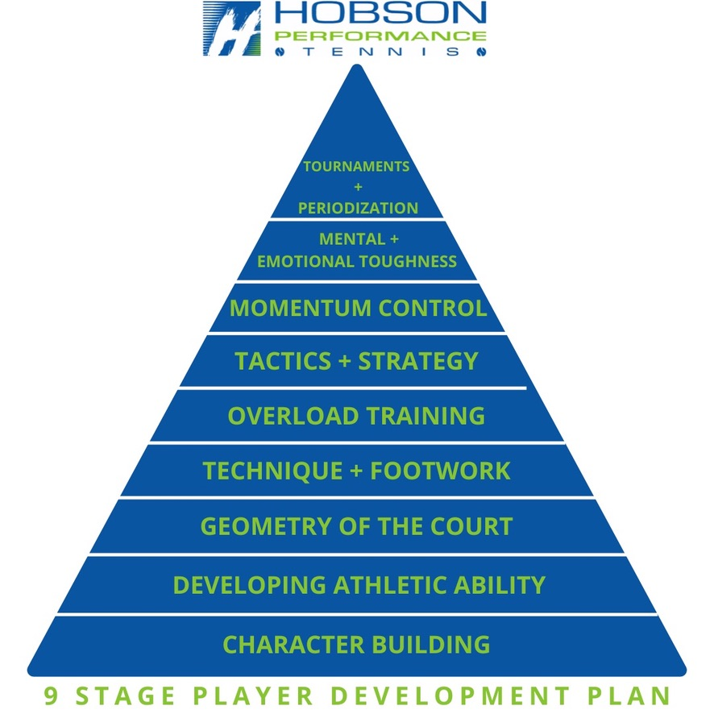
SINGLES RULES
Raising your tennis IQ

Slide 2
Good Singles Tennis IQ
Agg margin (winners and errors)
First serve in vs second serve in
Serve + 1 Patterns
Forcing and error
Returns
Attack second serves
Serve plus FH
FH – Inside In - Out
Weapon vs weakness
8 ways to force an error
Dropshots / short slice
Passing shots
Side T
Serve and volley 20%
Positioning
Basic patterns / 1-2 combos
First volley and alternatives
First exchanges 1-4 shots, 5-9 meat of the point, 9+ shots
3 zones of the court
Approaching the net
7 target areas / tactical court

Slide 3
Good Singles Tennis IQ
22-Control center
23-Directionals – 4 foundations
24-Tempo
25-Tactics – 70-30 rule
26-DNO / OND
27-Hold the line
28-Changing gears (variety)
29-Power Scale
30-Short ball
31-Red orange yellow / Scoring in tennis
32-Momentum

Slide 4
Winners and Errors
MEN – 2012 Grand Slams
Men Total Errors = 70.7%
Men Total Winners = 29.3%
WOMEN – 2012 Grand Slams
Women Total Errors = 74.1%
Women Total Winners = 25.9%
 |  |  |  | Winners Errors
Men | Points | Winners | Errors | Winners % | Errors %
Australian Open | 27,440 | 6789 | 20,651 | 25% | 75%
Roland Garros | 28,233 | 9323 | 18,910 | 33% | 66%
Wimbledon | 29,290 | 10,203 | 19,087 | 35% | 65%
U.S. Open | 29,038 | 7151 | 21,887 | 25% | 75%
Totals | 114,001 | 33,474 | 80,527 | 29.3% | 70.7%
Women | Points | Winners | Errors | Winners % | Errors %
Australian Open | 16,479 | 3678 | 12,801 | 22% | 78%
French Open | 17,283 | 5323 | 11,960 | 31% | 69%
Wimbledon | 17,741 | 5384 | 12,357 | 30% | 70%
U.S. Open | 16,862 | 3267 | 13,595 | 19% | 81%
Totals | 68,315 | 17,652 | 50,663 | 25.9% | 74.1%

Slide 5
The Aggressive Margin
Two important statistics that are necessary for a thorough understanding of match outcomes are Forced Errors/Winner and Unforced Errors. It is crucial to review what these statistics mean and why they are significant in comprehending matches.
A Forced Error occurs when a player makes an error due to the pressure created by their opponent's shot. This is different from the more familiar concept of an Unforced Error, which is a mistake made by a player on an easy or routine shot because of their inability to execute it properly.
A player can generate a Forced Error through the speed or placement of their shots, or both. For example, if they hit a deep, high-speed crosscourt forehand, the other player may struggle to control the ball and return it into the court despite having a chance to do so. The error in this case was "forced" by the aggressive play of their opponent.
Forced Errors are crucial statistics as they account for up to half or more of the points in most matches.
To truly gauge match performance, it is essential to track Forced Errors. Once we start tracking these errors, we can combine them with other well-known stats such as Winners and Unforced Errors to calculate another key statistic known as the Aggressive Margin.
The Aggressive Margin is determined by adding up a player's Winners and Forced Errors and subtracting their Unforced Errors. For instance, if a player hits 10 Winners and generates 10 Forced Errors while making 10 Unforced Errors, their Aggressive Margin would be +10 (20 - 10 = 10).
The Aggressive Margin provides immediate insight into how exactly a match was won or lost. It can be either positive or negative, indicating whether players rely on aggressive play or simply hope for more errors from their opponents.
It's important to note that the Aggressive Margin is not absolute but rather reflects the quality of points and shotmaking between specific players at a particular level in a given match.

Slide 6
This principle of playing positive percentage tennis appears to be universally followed by successful players at all levels. They understand their shot making abilities and utilize them to establish winning point patterns.
Statistical tennis is the key to victory. The best players achieve more points than they lose by employing proper patterns and executing high-percentage shots.
Developing the ability to win points through positive shot making is crucial for success, ensuring that one's positive shot making outweighs their unforced errors.
Unless a player can consistently play positive statistical tennis, their only hope is that their opponent has worse negative numbers. This explains why some players may win one match, thinking they played exceptionally well, but then struggle against another opponent playing in the same manner and end up losing badly.
WINNERS + FORCING SHOTS - UNFORCED ERRORS = AGGRESSIVE MARGIN
EG: 20 WINNERS + 10 FORCING – 20 UE = 10
PRO TOUR:
31% of points end as unforced errors
27% points and as winners
And 42% of points end as forced errors on the pro tour

Slide 7
Serving % - key to holding serve
MEN | Won | Total | Winning %
1st Serves Made | 16,971 | 29,038 | 58.4%
1st Serve Points Won | 12,186 | 16,971 | 71.8%
2nd Serve Points Won | 6,263 | 12,067 | 51.9%
Break Points Saved | 1,510 | 2,453 | 61.3%
Serve Games Won | 3609 | 4562 | 79.1%
WOMEN | Won | Total | Winning %
1st Serves Made | 10,211 | 16,862 | 60.5%
1st Serve Points Won | 6,446 | 10,211 | 63.1%
2nd Serve Points Won | 3,030 | 6,651 | 45.5%
Break Points Saved | 1,014 | 1,940 | 52.2%
Serve Games Won | 1,647 | 2,573 | 64.0%
The difference in winning points on 1st serve vs 2nd serve is around 20%. On game points – make your first serve!

Slide 8
Serve + 1 Patterns
Wide and Glide
Wide and Behind
Middle and Behind
Middle and Wide
Serve and volley
Serve into the body and attack
2nd serve and rally /
Neutralizing return
Defense

Slide 9
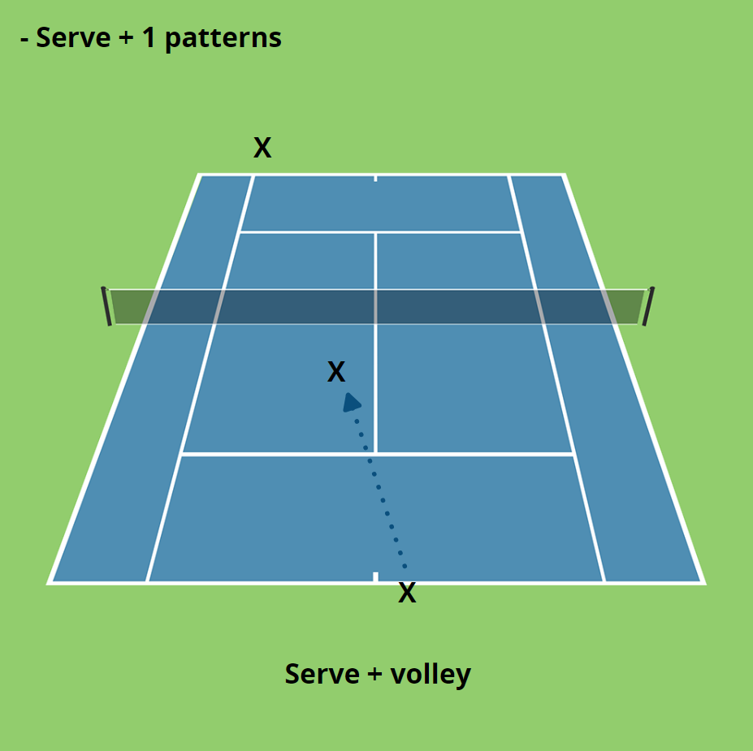

Slide 10
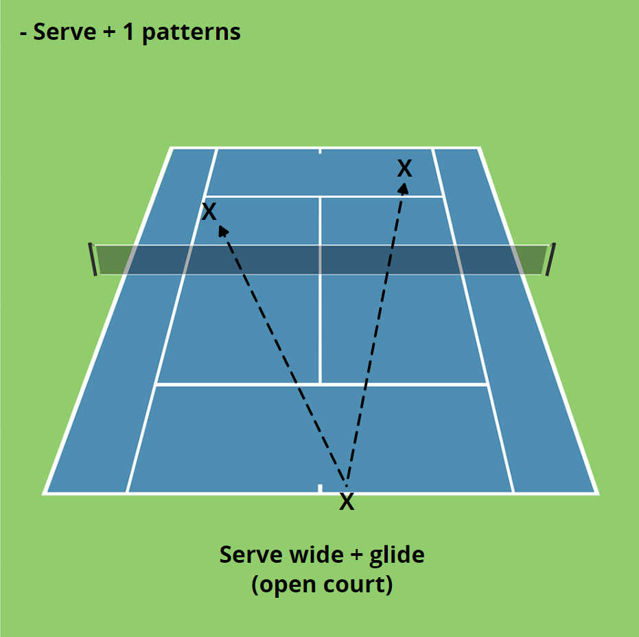

Slide 11
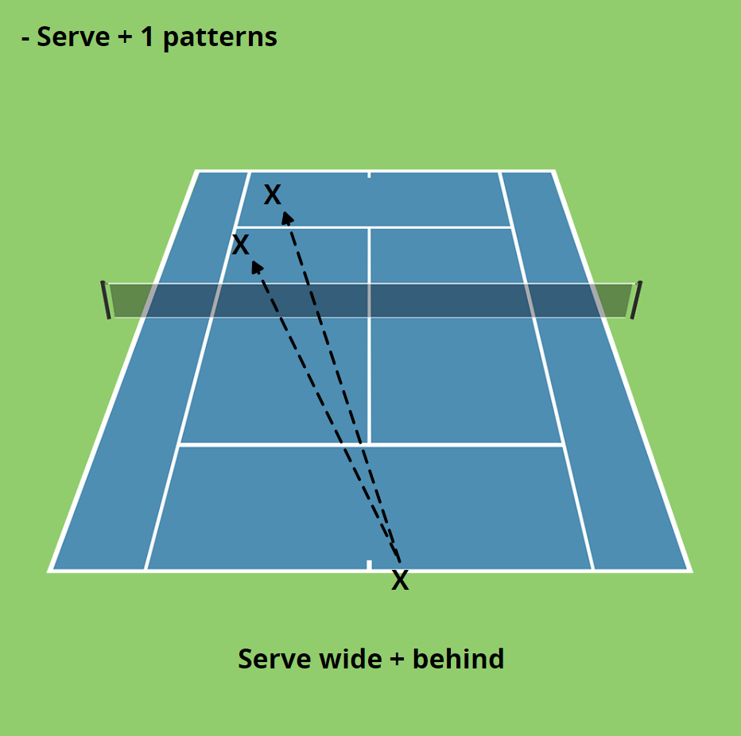

Slide 12
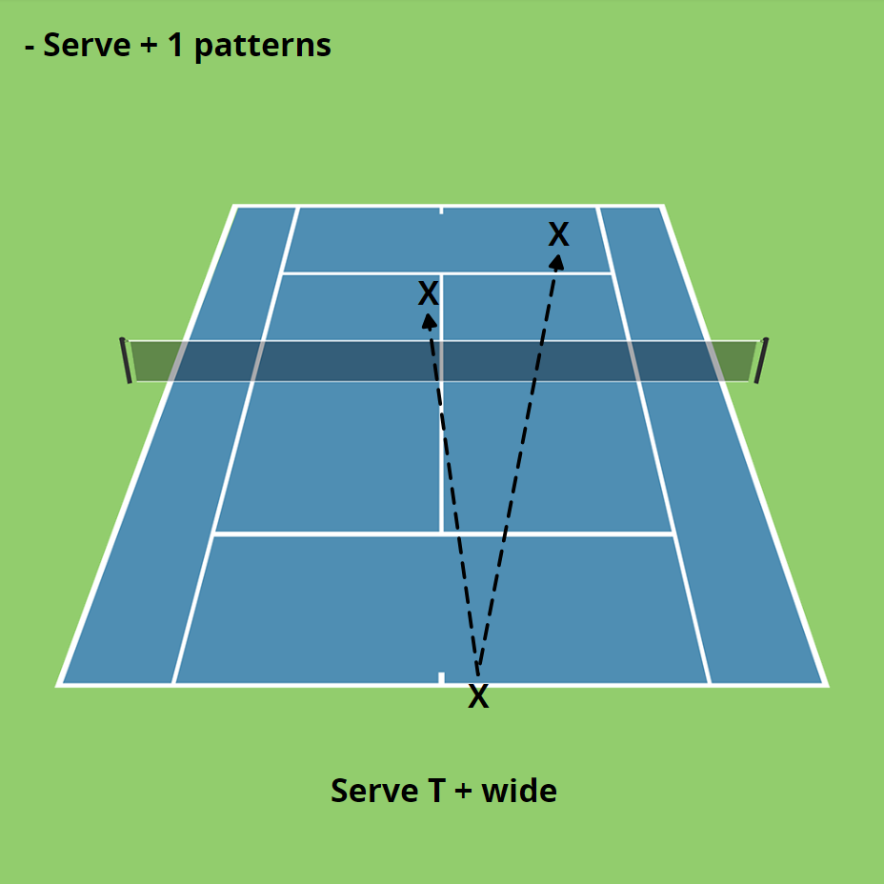

Slide 13
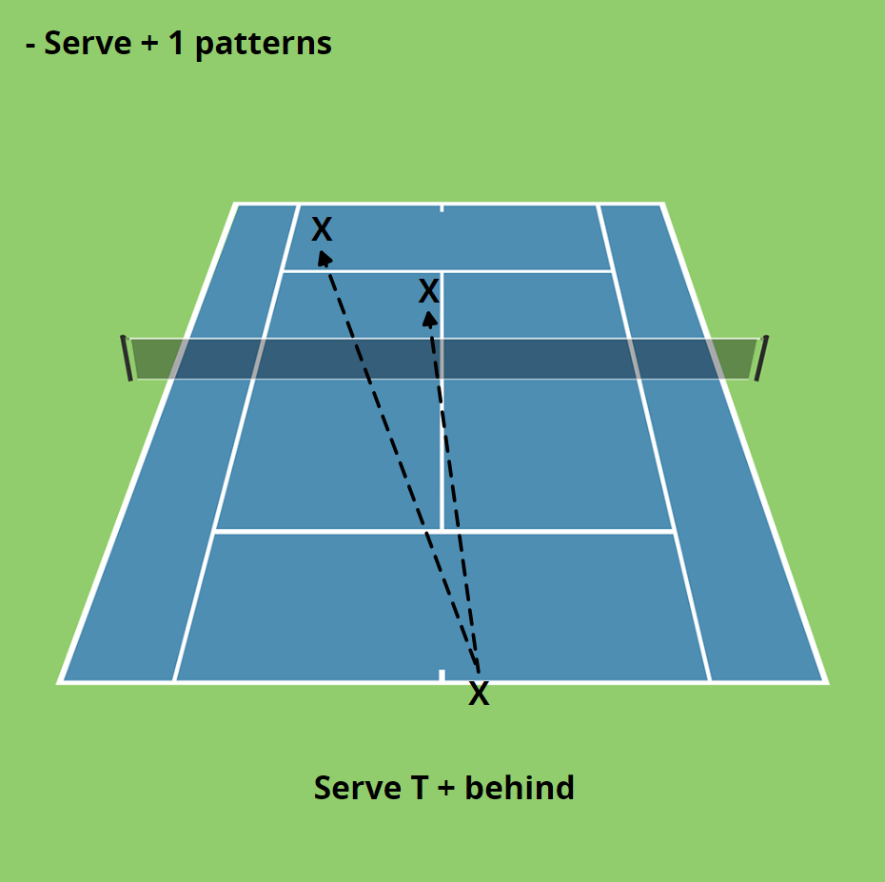

Slide 14
FORCING AN ERROR - 8 Ways
1. Consistency
Making one more shot than the other player. They force you to go for a lower percentage shot than you normally attempt because you know that their shot tolerance is better than yours.
2. Direction (left and right)
This involves three major areas. The first is the obvious one of hitting the ball away from your opponent and running them. The second involves hitting the ball directly at a weakness. The last is hitting behind your running opponent. This also taps into breaking down a shot by constantly hammering away at it. You know your opponent can make one or two backhands but can they make five in a row?
3. Depth (front and back)
Depth is what you should be chasing at the start of every point. It’s more important to push your opponent back where they can’t hurt you than move them a little and give them better geometry of the court. A deep ball is typically defined as landing closer to the baseline than the service line. Depth also involved drop shots and hitting short on purpose to bring your opponent forward.
4. Height (low and high)
Most players like to make contact with the ball around their waist, or at least below their shoulders.
5. Spin (topspin and backspin)
Spin is a nasty weapon that can make the ball dance all over the place. It makes the ball jump up sharply, making it difficult to step into and also skid and stay low under the strike zone. It’s not always easy to read spin and correctly adjust to, resulting in lots of errors.
6. Power (harder and softer)
7. Court Position (where you stand)
Where you stand visually expands and shrinks areas of the court that can have a large bearing on your opponent’s shot selection and propensity to miss.
8. Time (rushing your opponent)

Slide 15
Patterns
Tennis Is A Game Of Patterns
Primary Patterns (7-8 times out of 10)
Primary Patterns you use as much as much as you can. This is the play that you want to have a winning percentage with and also run when the match gets close at the end of each set.
Secondary Patterns (2-3 times out of 10)
You switch it up with a secondary pattern (usually to the strength) for a complete surprise. Running enough primary patterns makes secondary patterns very successful when done at the right time. Don’t overdo this area – it’s the art of the surprise.

Slide 16
Federer –
First serves - deuce
SERVE PLACEMENT

Slide 17
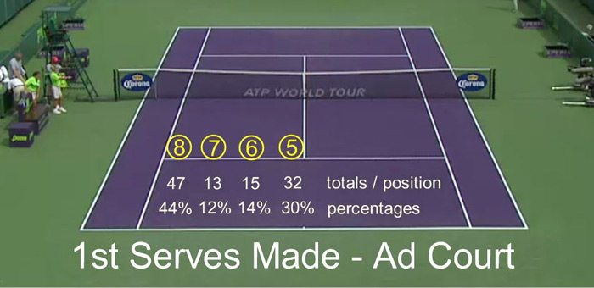
Federer –
Ad court

Slide 18
2nd Serve

Slide 19
2nd Serve

Slide 20
SERVING RULES
Below is a list of 9 factors that you should consider before serving, whether it's your first or second serve, to increase your chances of winning the point:
1. Where does my opponent expect me to serve?
Your opponent will have a better chance of returning your serve if they know where it's going. While you may have preferred serving locations, it's important to mix them up enough so that your opponent remains uncertain. This is the most crucial factor to keep in mind before hitting a serve.
2. Positioning - vary where you serve from on the court
3. Where do I want the ball to come back?
In tennis, around two-thirds of first serves are returned and nearly 90% of second serves come back in play. You can control the angle of the return by dictating whether you'll get to hit a forehand or backhand as your first shot after serving.
4. What are my opponent's strengths and weaknesses?
You have two options here: attack immediately based on your opponent's weakness or create openings on the court and apply pressure once the rally starts. Regardless, it's important to find ways that match up with what makes your opponent uncomfortable.
5. What is the score?
Considering the score is crucial as it affects both players' mental pressure levels significantly. In general, when leading in points, you'll want to mix up more; however, when facing tighter scores with greater importance placed on each point, sticking more closely to primary patterns might be wise.
6. What is my preferred serve?

Slide 21
SERVING RULES
7. What is my highest percentage serve?
There will be moments in a match where getting your first serve in becomes more important than aiming for a specific location. Considering the spin of your serve (whether it's flat, sliced, or kicked) is also crucial as there may be situations where preventing your opponent from taking a good look at your second serve is the most vital factor.
8. What are the natural conditions (sun, wind, slope of court)?
Factors like sun, wind, and even the slope of the court should all be taken into account to increase your chances of winning the point. They can have significant effects on tactics at both ends of the court and should play a role in your decision-making process.
9. Where is my opponent positioned?
Most players tend to stand in fixed positions when returning serves. Understanding and utilizing this information allows you to use their position as an advantage against them effectively. It's surprising how little players change their return positions even when you're consistently targeting certain locations with strong serves.

Slide 22
SERVE PLUS FOREHAND - NADAL
SECOND SHOT
Year | Event | Rd | Opponent | W/L | Score | Serve + 1 FH % | Winning %
2014 | Australian Open | Semi | Roger Federer | W | 7-6 (4) 6-3, 6-3 | 73% (45/62) | 69% (31/45)
2013 | US Open | Final | Novak Djokovic | W | 6-2, 3-6, 6-4, 6-1 | 78% (76/97) | 58% (44/76)
2013 | Montreal | Final | Milos Raonic | W | 6-2, 6-2 | 91% (20/22) | 70% (14/20)
2013 | Cincinnati | Qtr | Roger Federer | W | 5-7, 6-4,6-3 | 75% (51/68) | 71% (36/51)
2013 | Roland Garros | Final | David Ferrer | W | 6-3, 6-2, 6-3 | 59% (37/63) | 65% (24/37)
2013 | Rome | Final | Roger Federer | W | 6-1, 6-3 | 63% (17/27) | 59% (10/17)
2013 | Madrid | Final | Stan Wawrinka | W | 6-2, 6-4 | 89% (26/29) | 80% (21/26)
2013 | Monte Carlo | Final | Novak Djokovic | L | 6-2, 7-6 (1) | 67% (23/34) | 60% (14/23)
2013 | Indian Wells | Final | J.M. Del Potro | W | 4-6, 6-3, 6-4 | 85% (53/62) | 66% (35/53)
2012 | Roland Garros | Final | Novak Djokovic | W | 6-4, 6-3, 2-6, 7-5 | 80% (63/78) | 50% (32/63)
2012 | Rome | Final | Novak Djokovic | W | 7-5, 6-3 | 83% (47/56) | 61% (29/47)
2012 | Monte Carlo | Final | Novak Djokovic | W | 6-3, 6-1 | 81% (18/22) | 72% (13/18)
2010 | Toronto | Rd 3 | Kevin Anderson | W | 6-2, 7-6(6) | 72% (29/40) | 65% (19/29)
2010 | Roland Garros | Final | Robin Soderling | W | 6-4, 6-3, 6-4 | 83% (56/77) | 64% (36/56)
2010 | Wimbledon | Final | Tomas Berdych | W | 6-3, 7-5, 6-4 | 89% (48/54) | 70% (34/48)
2010 | Rome | Semi | Ernests Gulbis | W | 6-4, 3-6, 6-4 | 78% (54/69) | 61% (33/54)
2010 | Rome | Rd16 | Victor Hanescu | W | 6-3, 6-2 | 85% (40/47) | 62% (25/40)
2010 | Monte Carlo | Rd16 | Michael Berrer | W | 6-0, 6-1 | 92% (26/28) | 84% (22/26)

Slide 23
Returns – make them better !
es Won | Totals | Winning %
Men | 953 / 4,562 | 20.8%
Women | 926 / 2,573 | 35.9%
U.S. Open Analytics
Men Return Games Won Winning % = 20.8%
Women Return Games Won Winning % = 35.9%
Men break serve 1/5 and women break serves 1/3 games on average

Slide 24
Serve Situations
Making 60% 1st serves is very attainable at all levels of the game.
Win 70% 1st serve points by a combo of hitting your spots really well and power of 1st serve.
Win 50% second serve points. Calling it a wash is really a win. Reduce double faults & jam the backhand.
Save 60% of your break points. Run your primary patterns of play on the points that matter the most.
Win 80% of your service games. You are going to average getting broken once a set. Don’t meltdown when it happens.

Slide 25
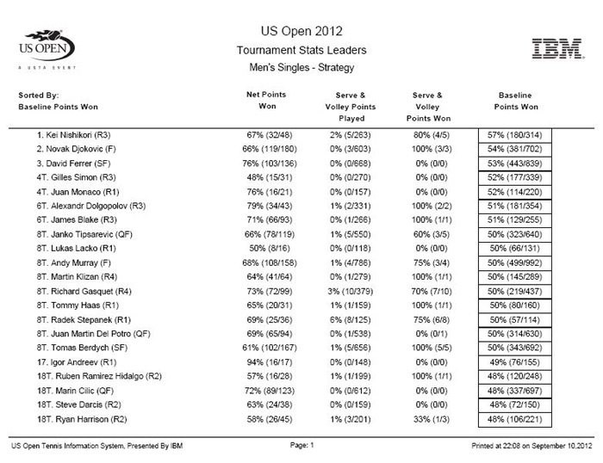
Baseline – 50 % - mens

Slide 26
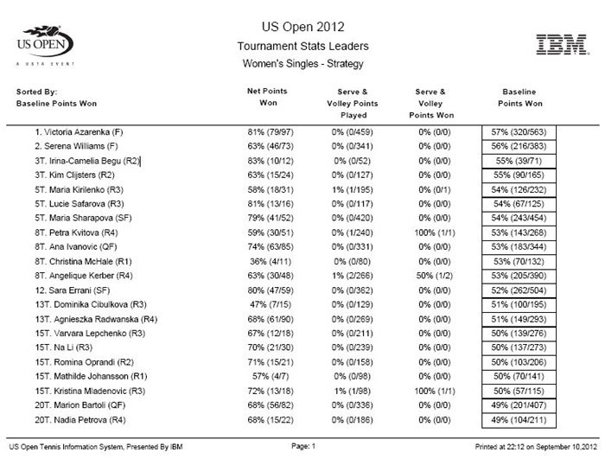
Baseline – 50 % - womens

Slide 27
SERVE AND VOLLEY
U.S. Open Analytics
MEN
Won 349 of 508 points serve and volley points.
58 players were recorded serving and volleying.
Only 11 players out of 58 had a losing record serving and volleying.
16 players won 100% of their serve and volley points.
31 players won more than 70% of their serve and volley points.
Men Serve & Volley Winning % = 68.7%
82% (47/58) of male players had a winning record
WOMEN
Won 18 of 26 serve and volley points.
There were only 10 women who attempted it and only two of the 10 did it twice. Seven of the 10 won every point they attempted. These number beg the question – why in the world is it not done more?
Women Serve & Volley Winning % = 69.2%

Slide 28
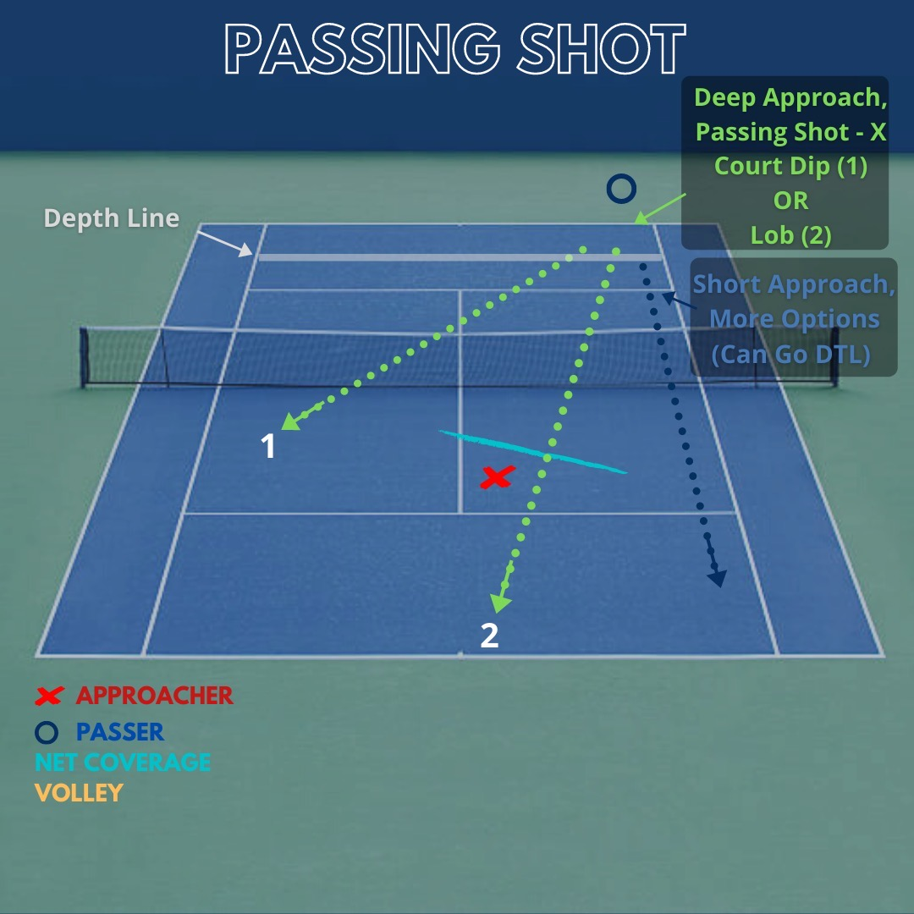

Slide 29
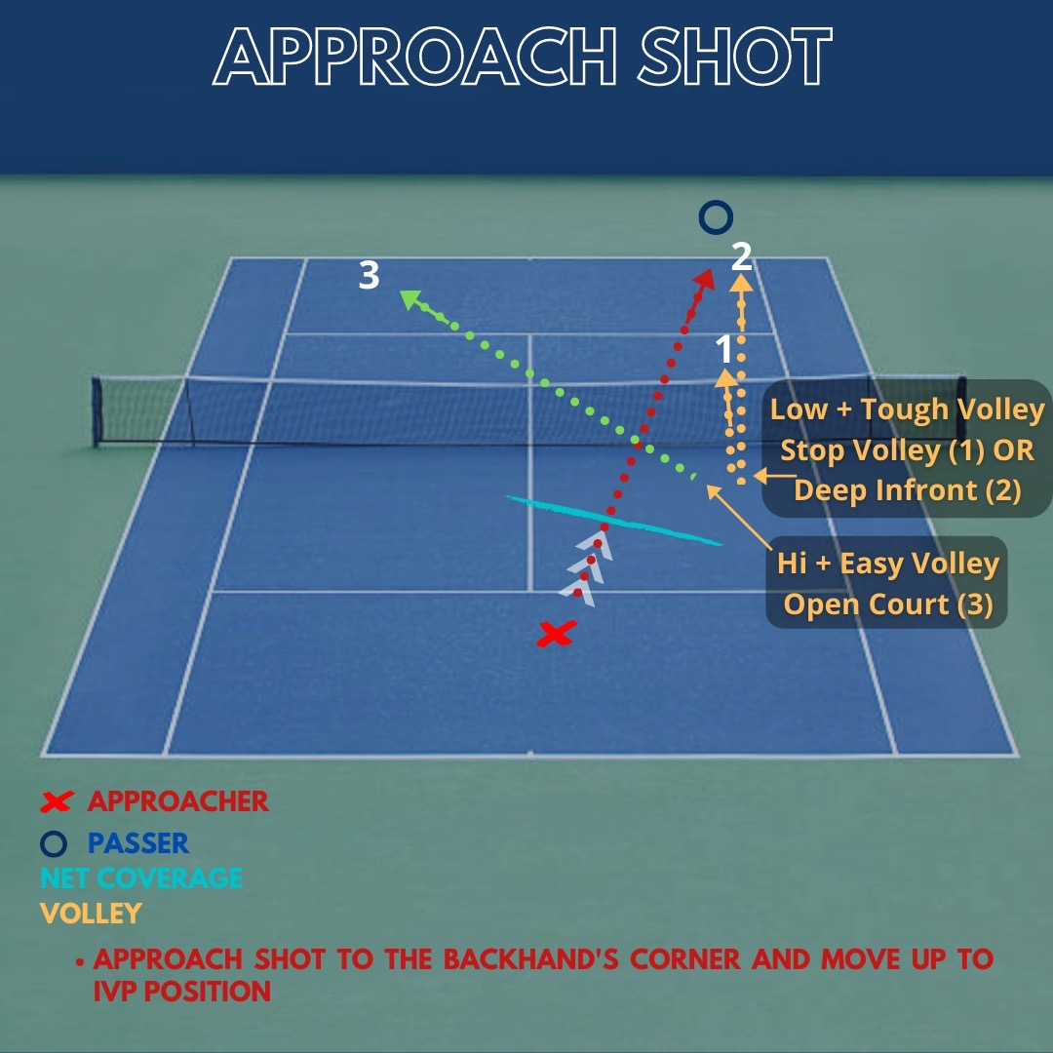

Slide 30
FOREHAND IS THE WEAPON
U.S. Open Analytics
Groundstroke Winners
Want the cold hard facts about baseline play? Well, here they are. Make sure you are sitting down.
MEN
Forehand winners = 2271
Backhand winners = 1084
Forehand Winners = 68%
Backhand Winners = 32%
WOMEN
Forehand winners = 1327
Backhand winners = 720
Forehand Winners = 65%
Backhand Winners = 35%

Slide 31
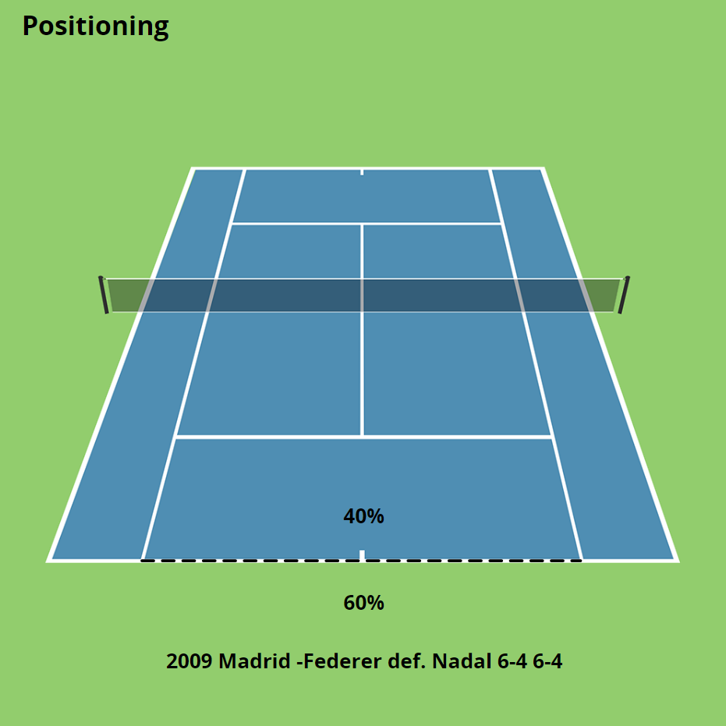

COURT POSITIONONG – Closer to the baseline – Federer’s contact points VS Nadal’s depth

Slide 32
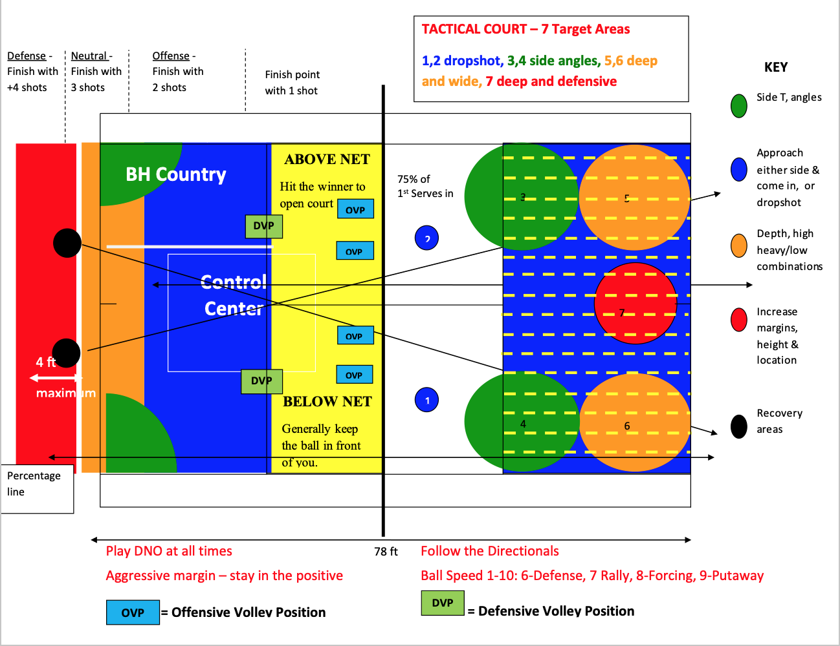
Tactical court

Slide 33
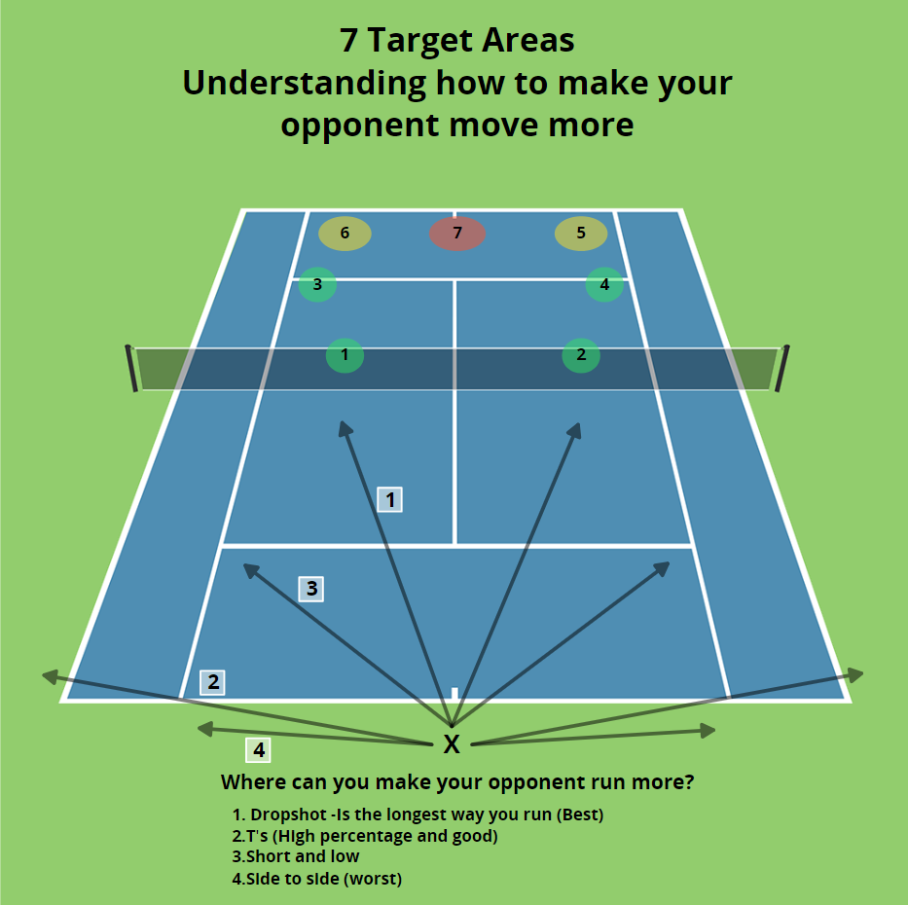

Slide 34
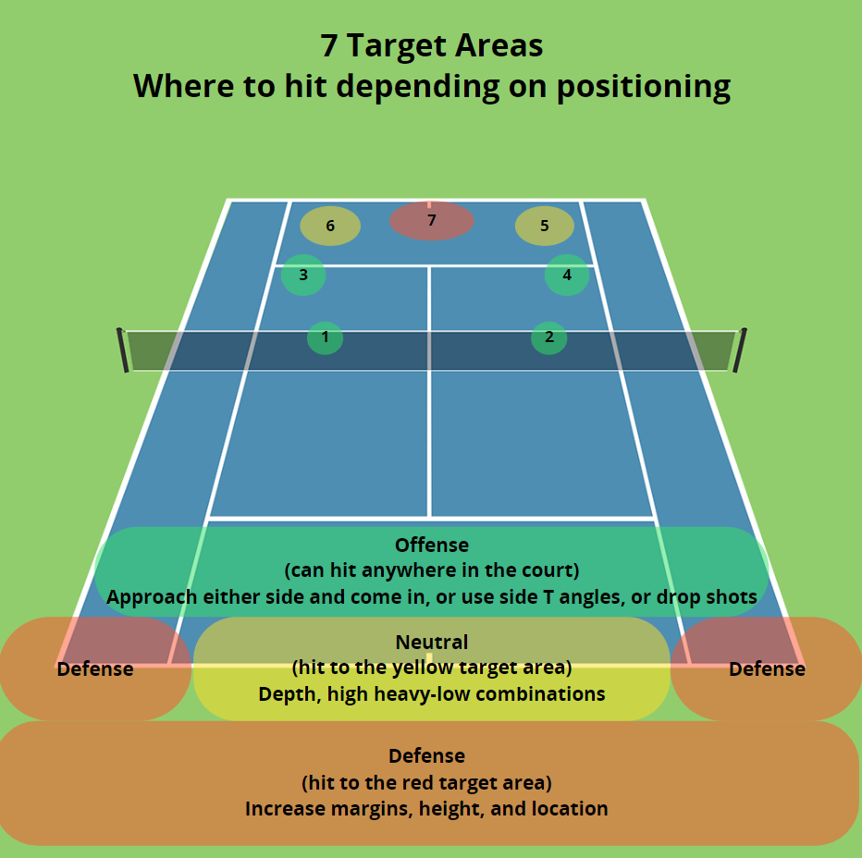

Slide 35
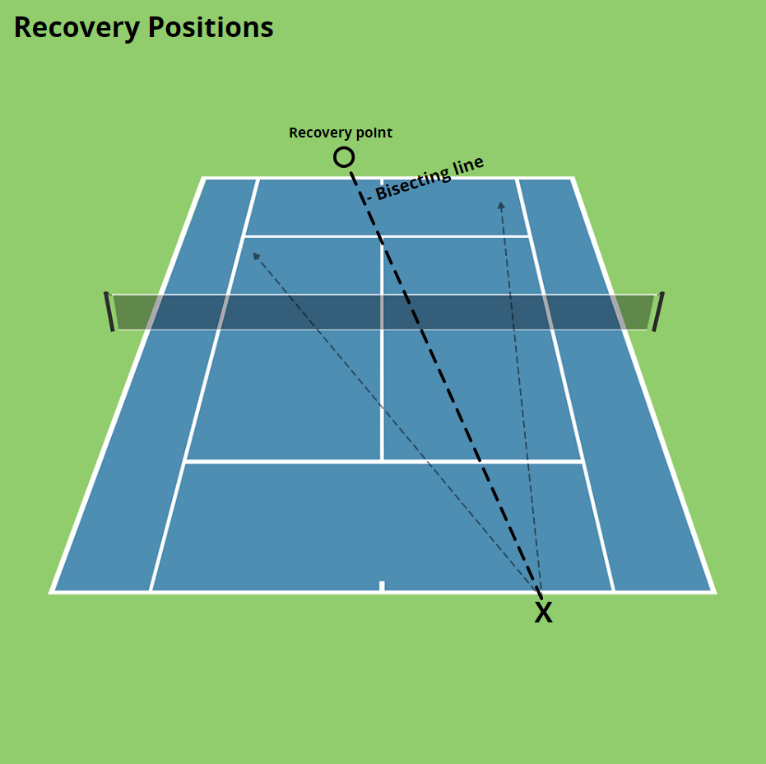
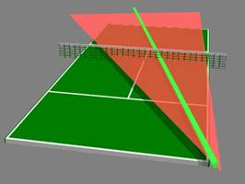
Positioning

Slide 36
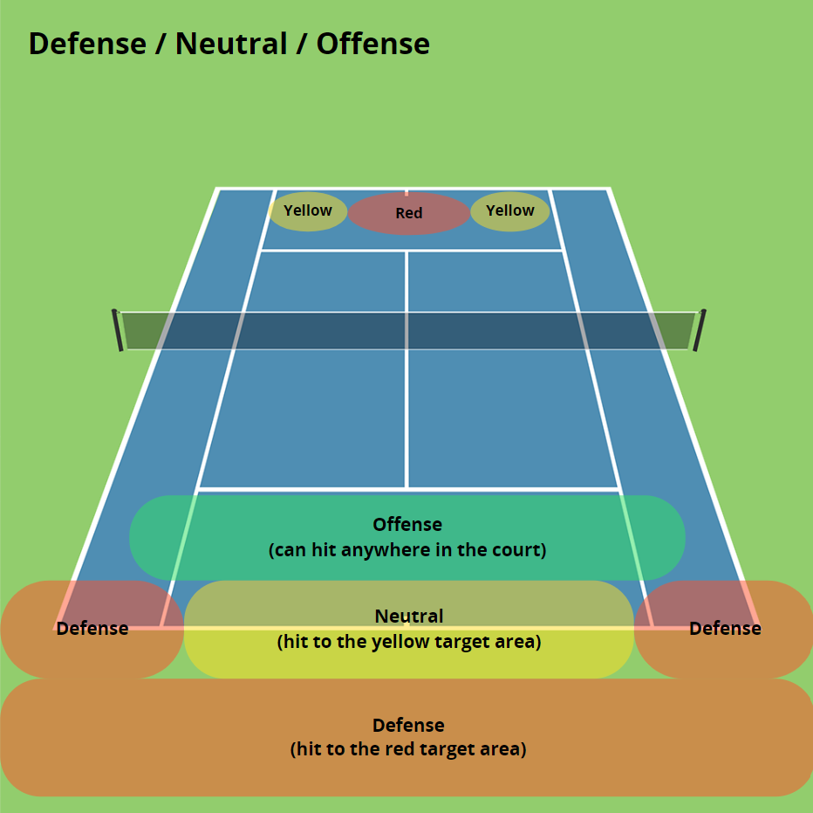

Slide 37
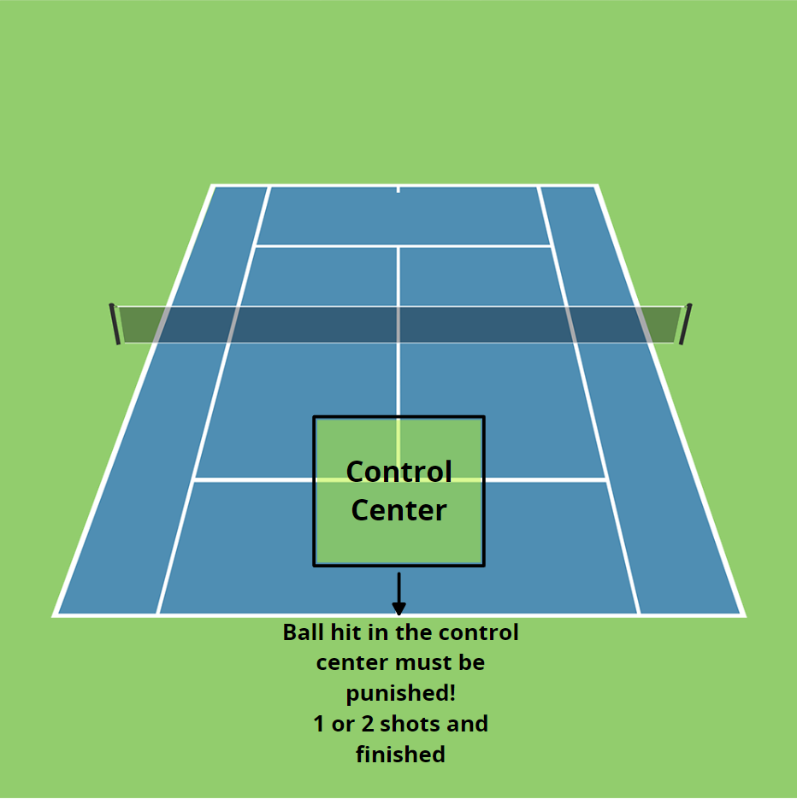

Slide 38
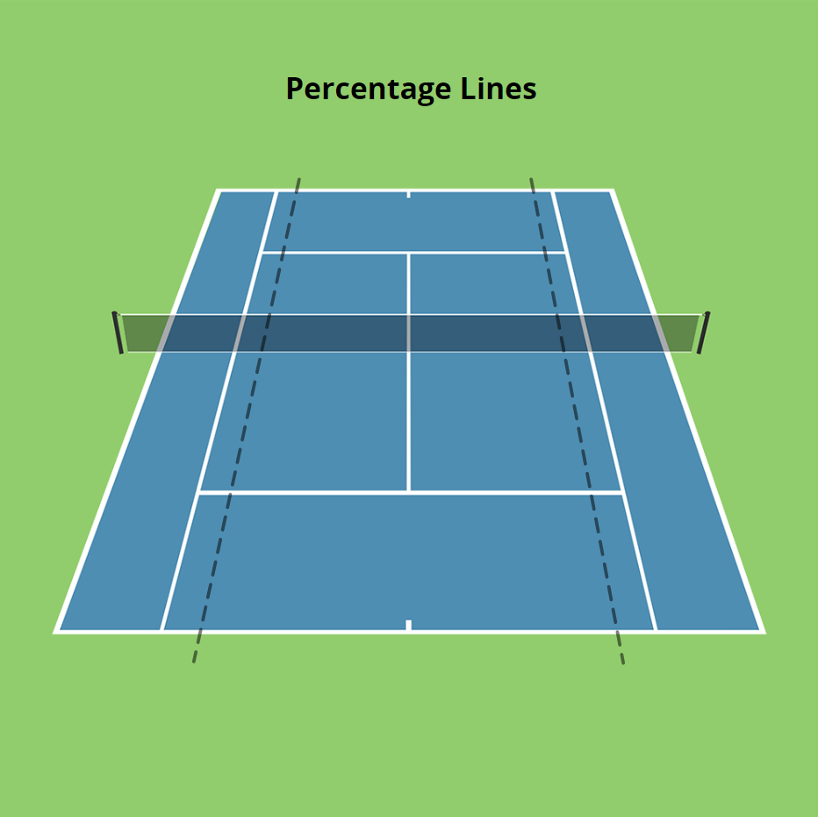
Court Percentages
+/- 5% of balls land within 8inches of the line
+/- 15% of balls land within 3 feet/1 meter of the line
Therefore, on average 85% of balls land at least 1 meter (3 feet) away from the lines
Average ball height above the net for men 2.5 feet. For woman 2.2 feet. Nadal is an outlier with 3 feet.
Therefore, when we add this to the targets, we can deduce that pros aren't looking to hit lines or winners all the time. Instead, they are aiming for big targets with safe margins.
Statistically, we therefore do not see players who try to only hit winners and go for the lines with small margins and neck clearance at the pro level
Therefore, looking to hurt your opponent with the first short ball or inside ball opportunity, taking control where you either get them off, balance, forcing an error or to the point where the ball out runs your opponent for a winner
(also, where do you have the greatest amount of angle, when you are up at the net, therefore following balls in and taking them out of the air makes statistical and geometrical sense)

Slide 39
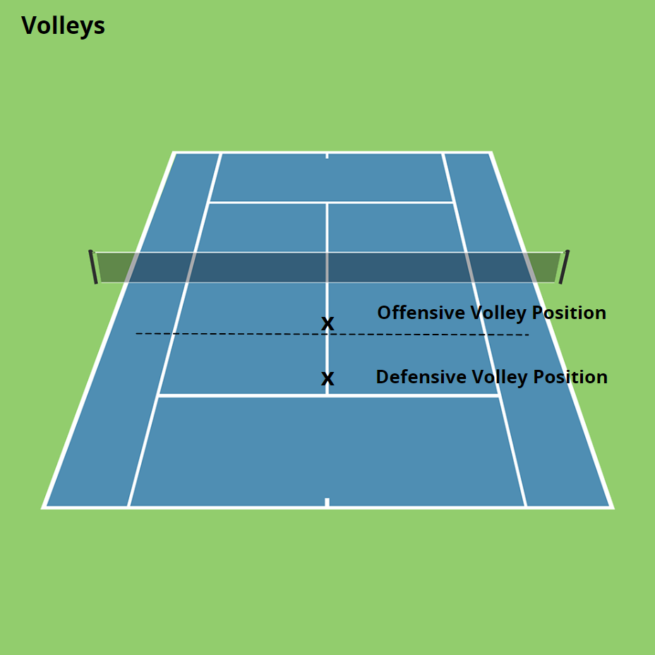

Slide 40
Directionals
Mission: Value of the directionals:
Make the correct tactical decisions
Play high % tennis
Play naturally without fighting your body – pull balls
Increase court coverage & anticipation. Move less.
Improve defense under pressure
Attack more effectively
Make your opponent move
Make passing shots “dip”

Slide 41
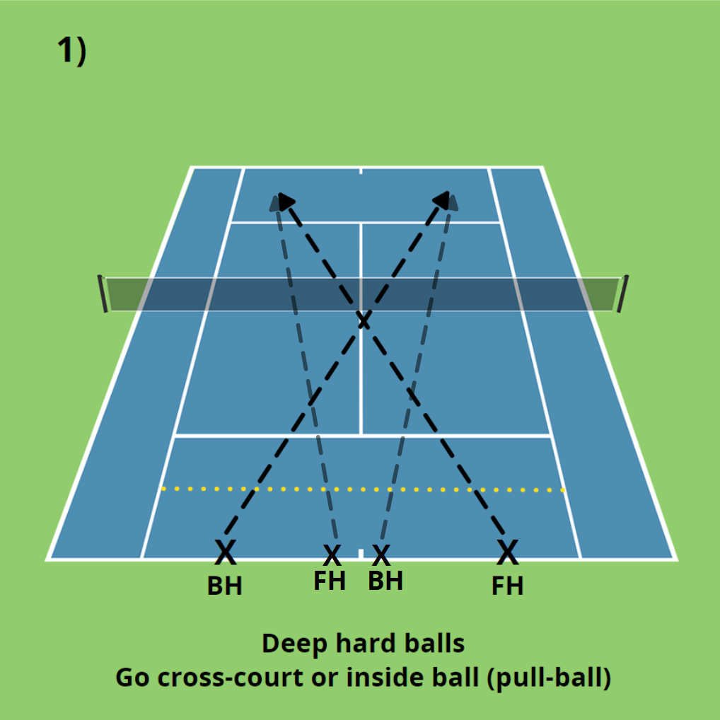
#1
Directionals
Deep balls are Pull balls go and go x court

Slide 42
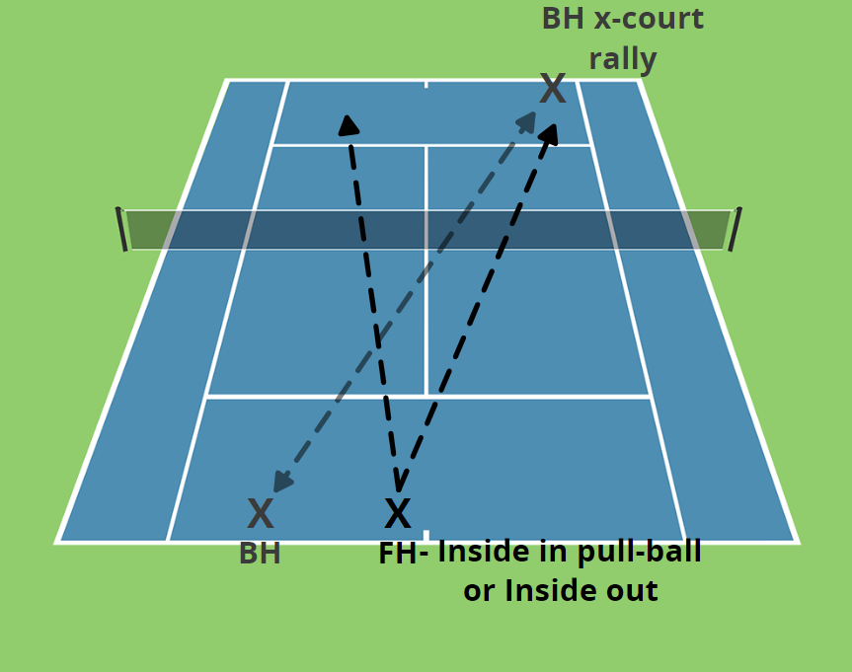
#2
BH cross crt rally – FH inside in or inside out

Slide 43
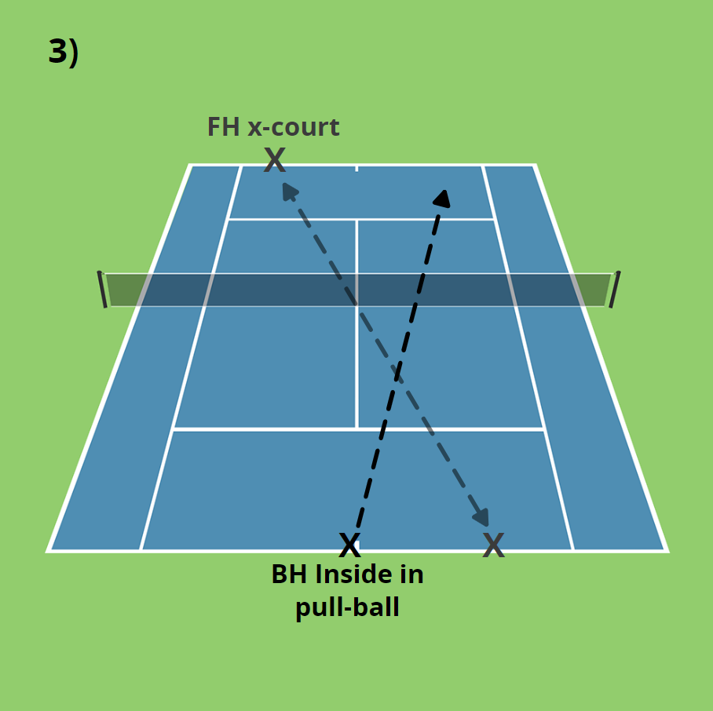
#3
Short or middle Backhands pull x crt

Slide 44
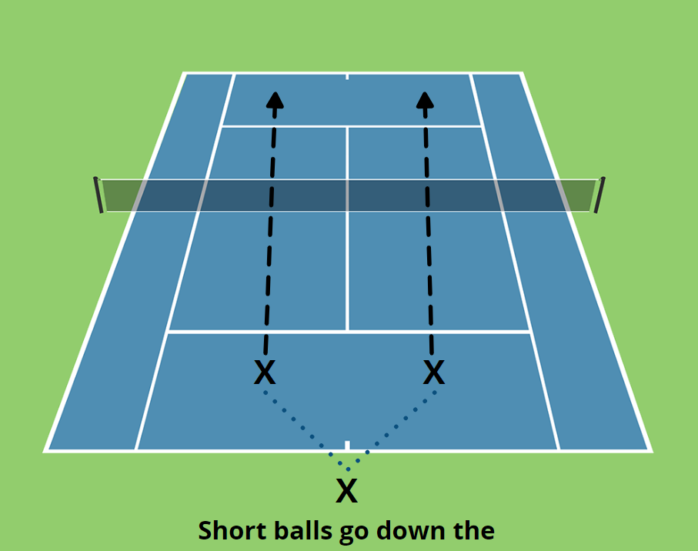
#4
High risk high payoff

Slide 45
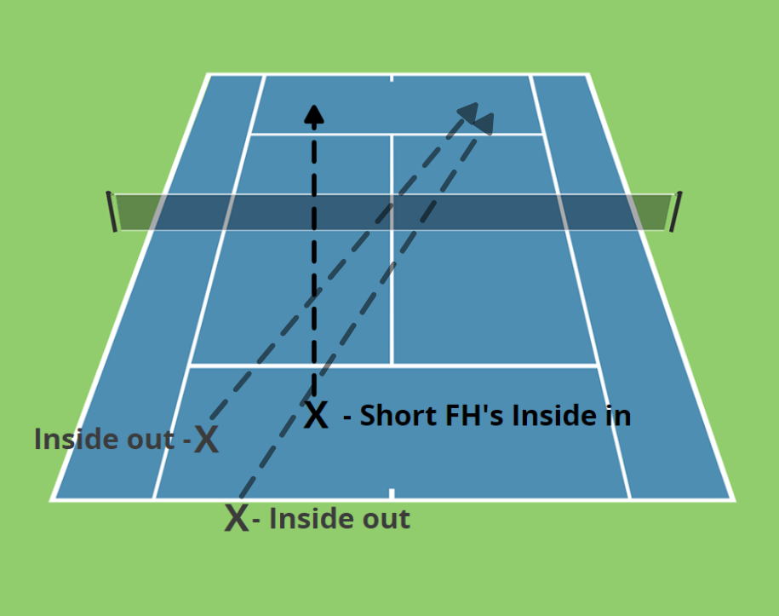
Forehands – wide and deep go inside out, short and middle – inside in

Slide 46
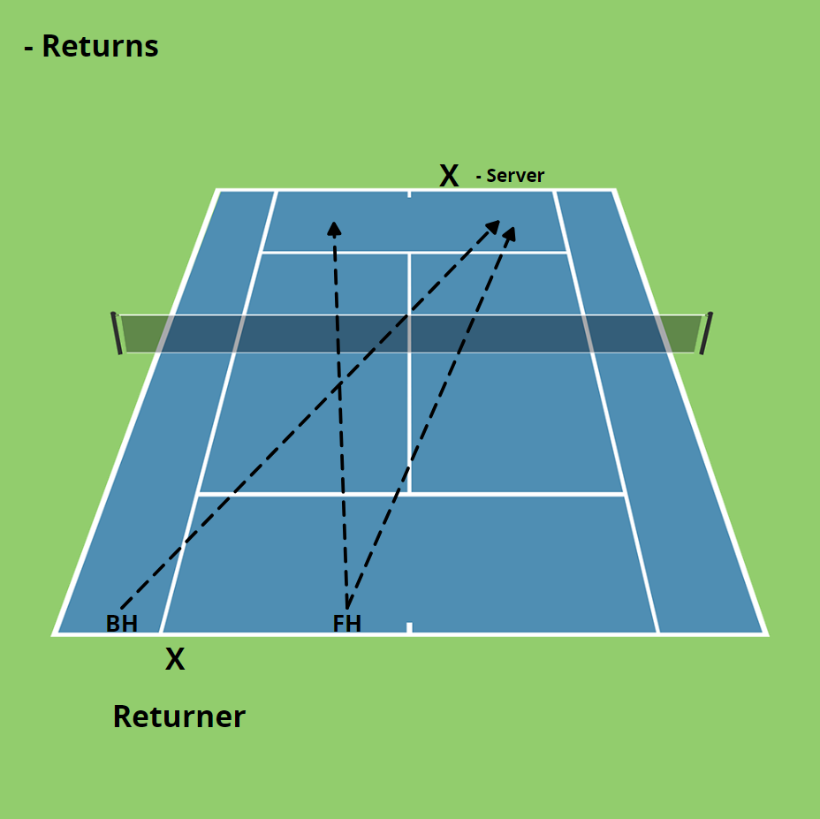

Slide 47
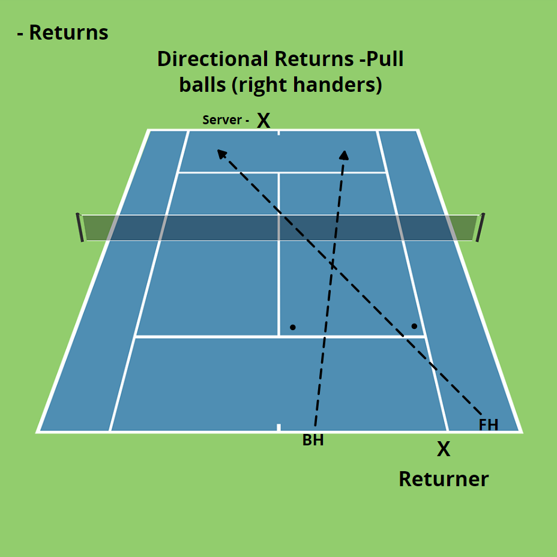

Slide 48
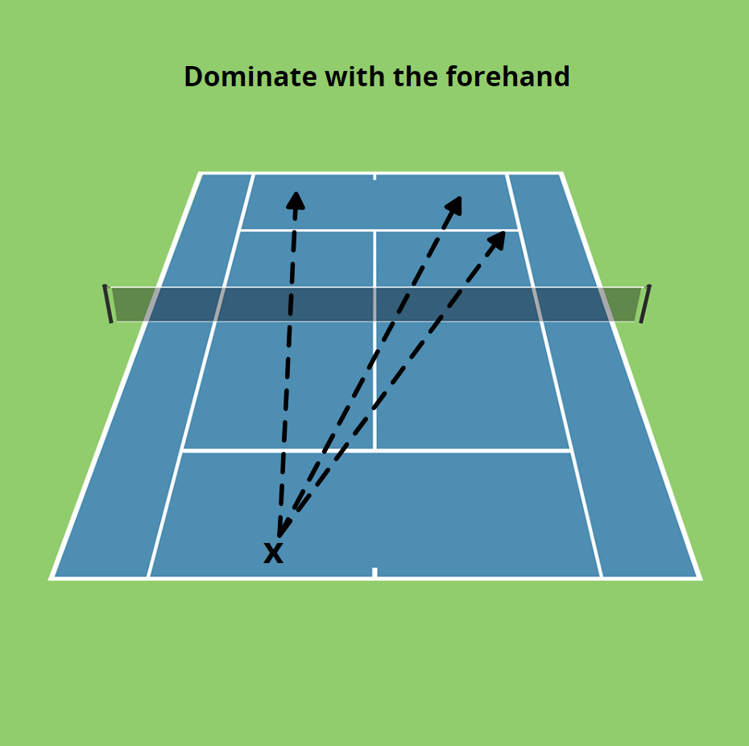

Slide 49
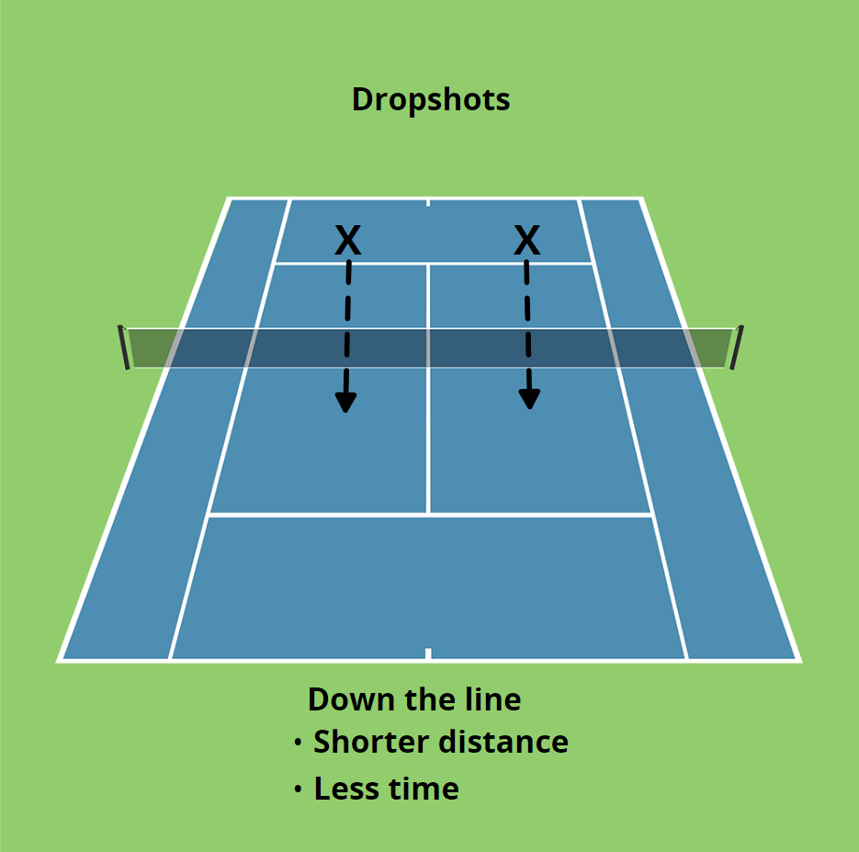

Slide 50
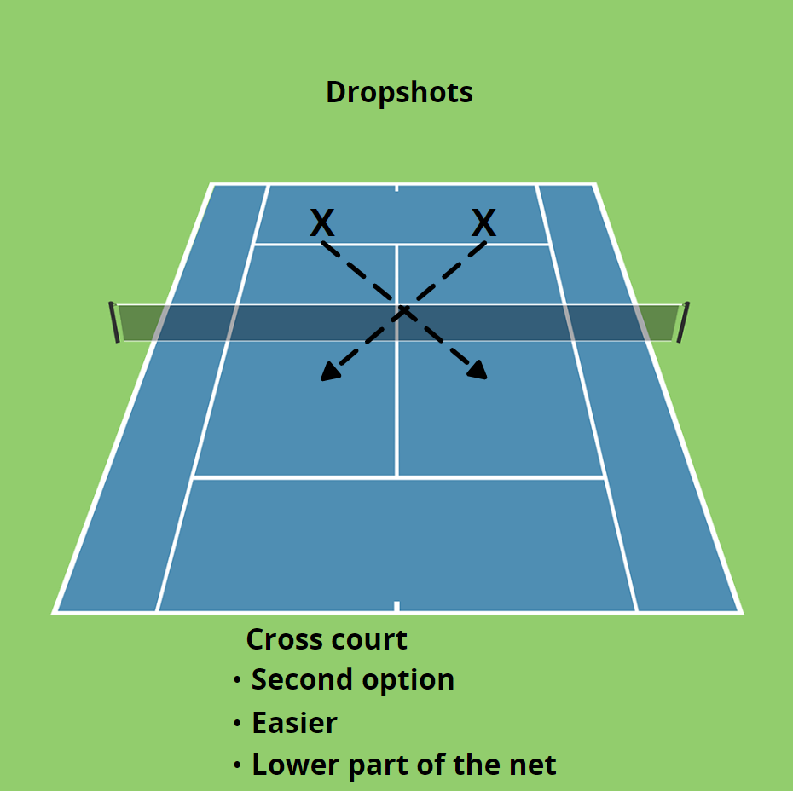

Slide 51
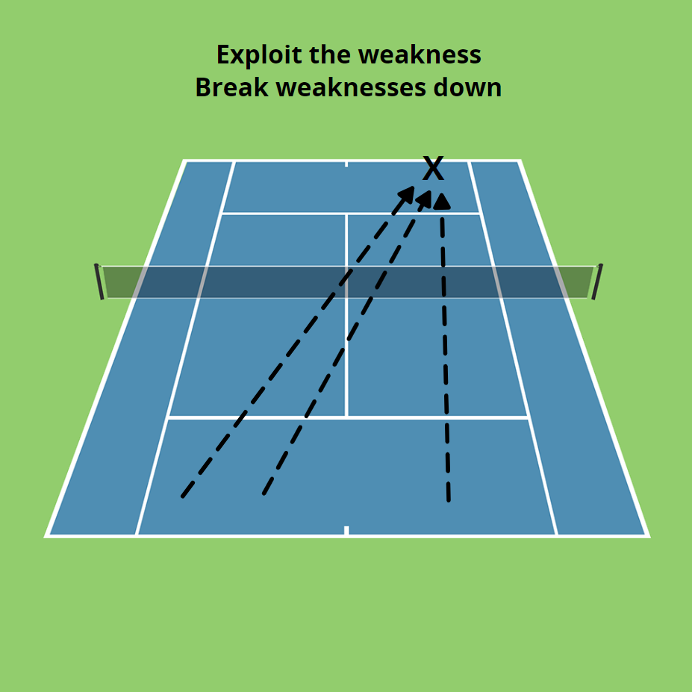
LIKE A BOXER, punish the weakness
Hit here until the other player cheats
to that side then exploit the open court

Slide 52
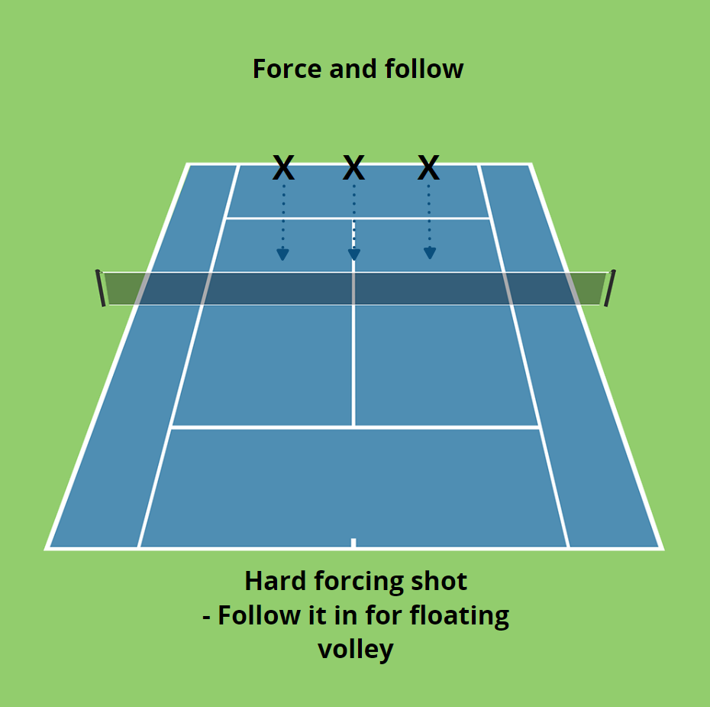

Slide 53
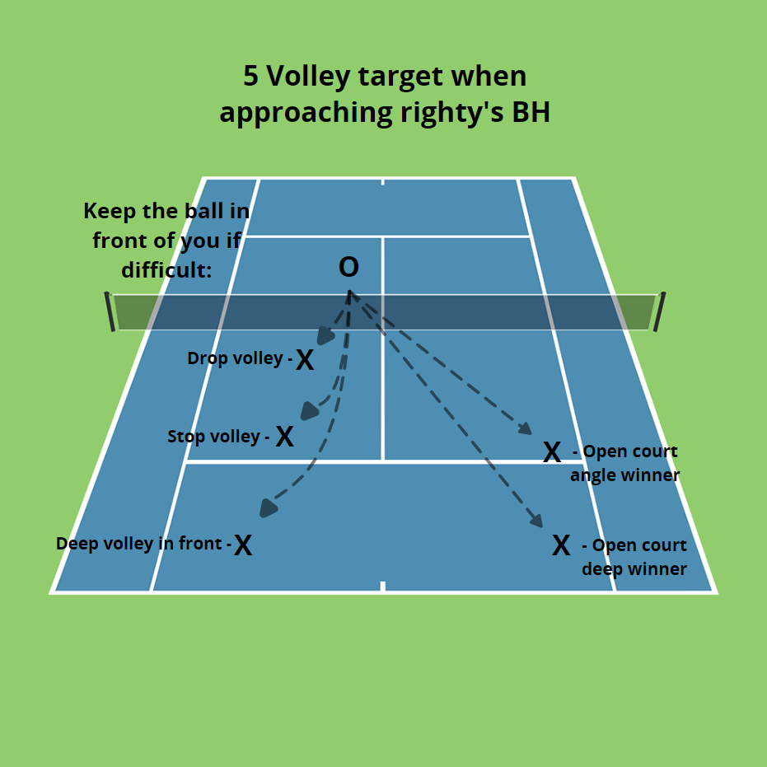

Slide 54
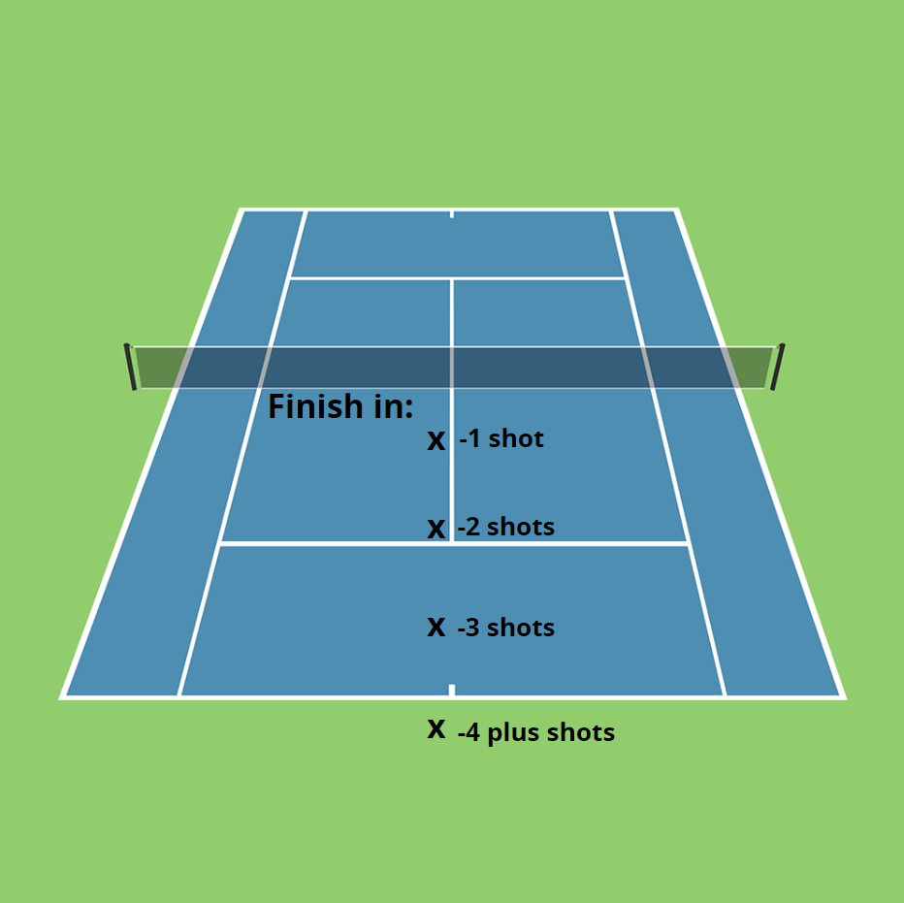

Slide 55
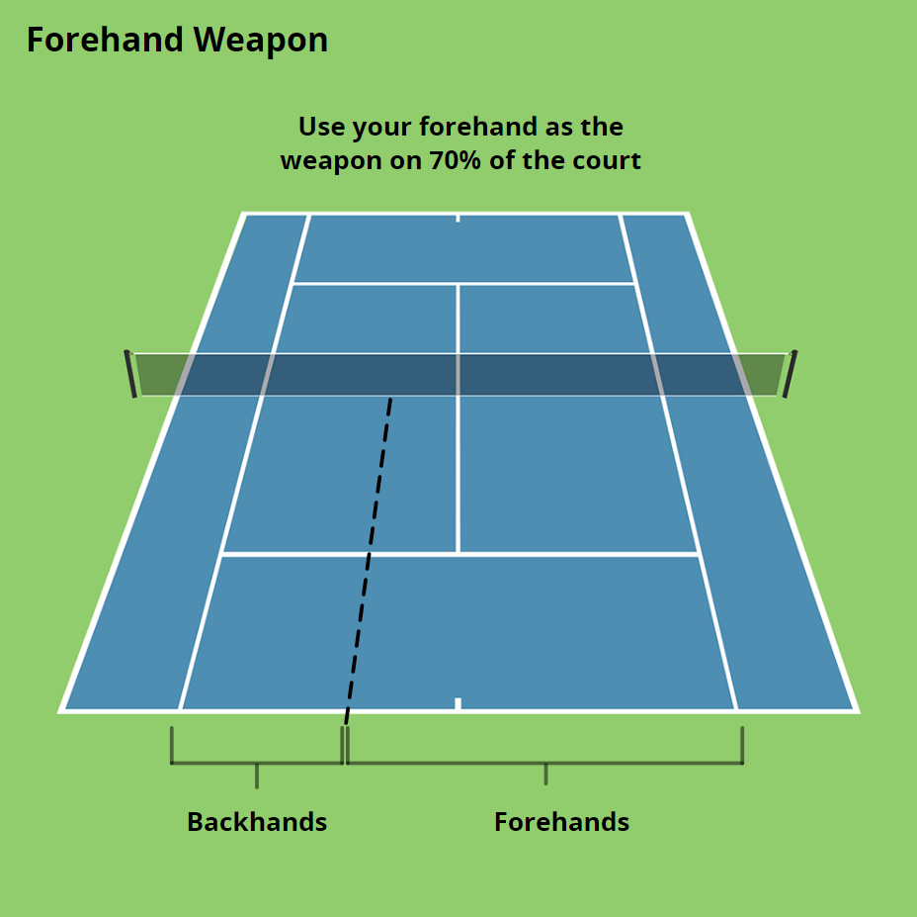

Slide 56
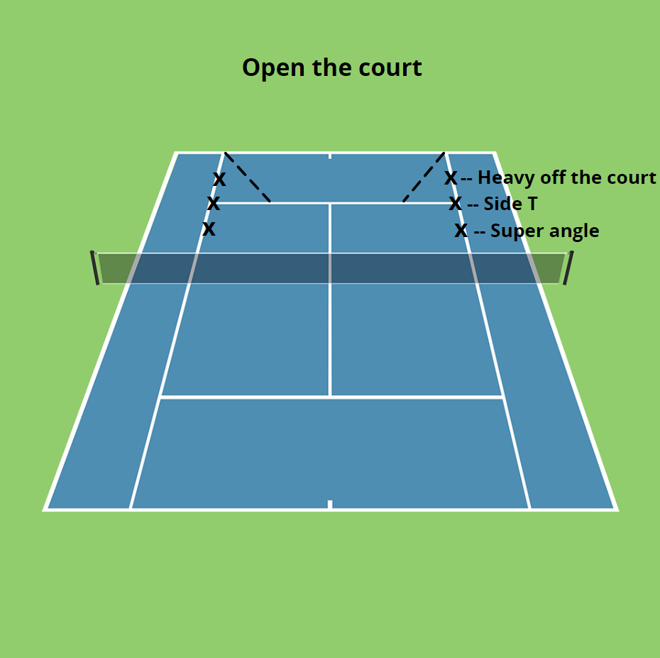

Slide 57
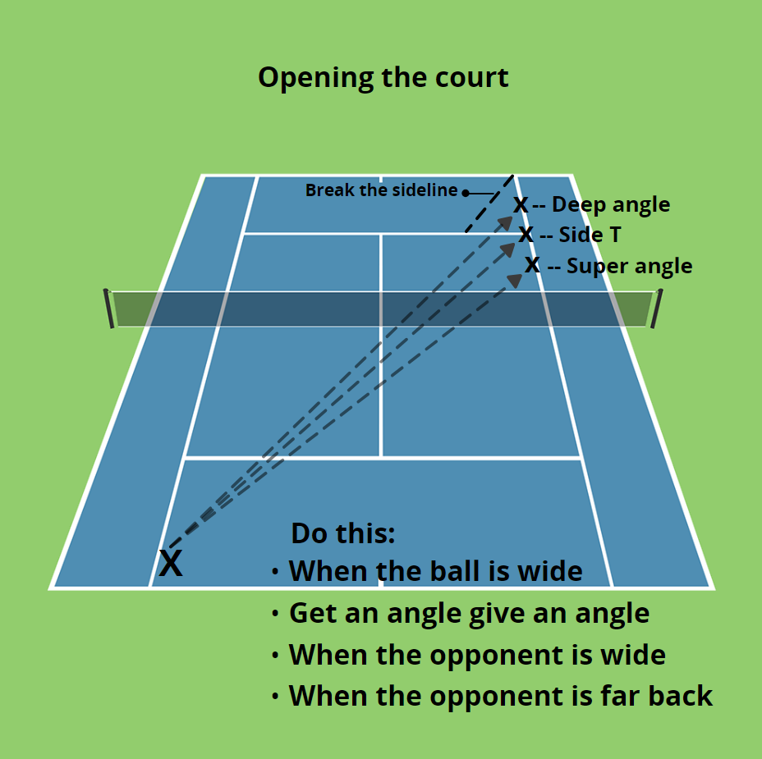

Slide 58
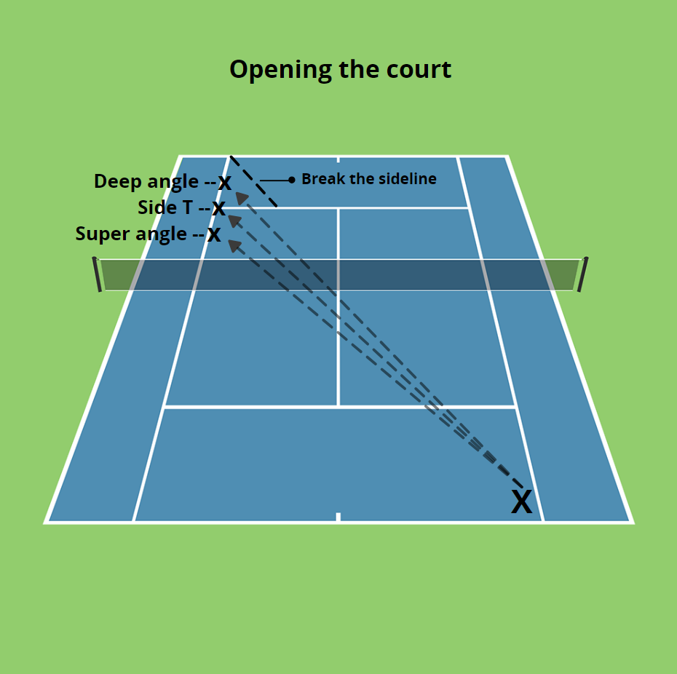

Slide 59
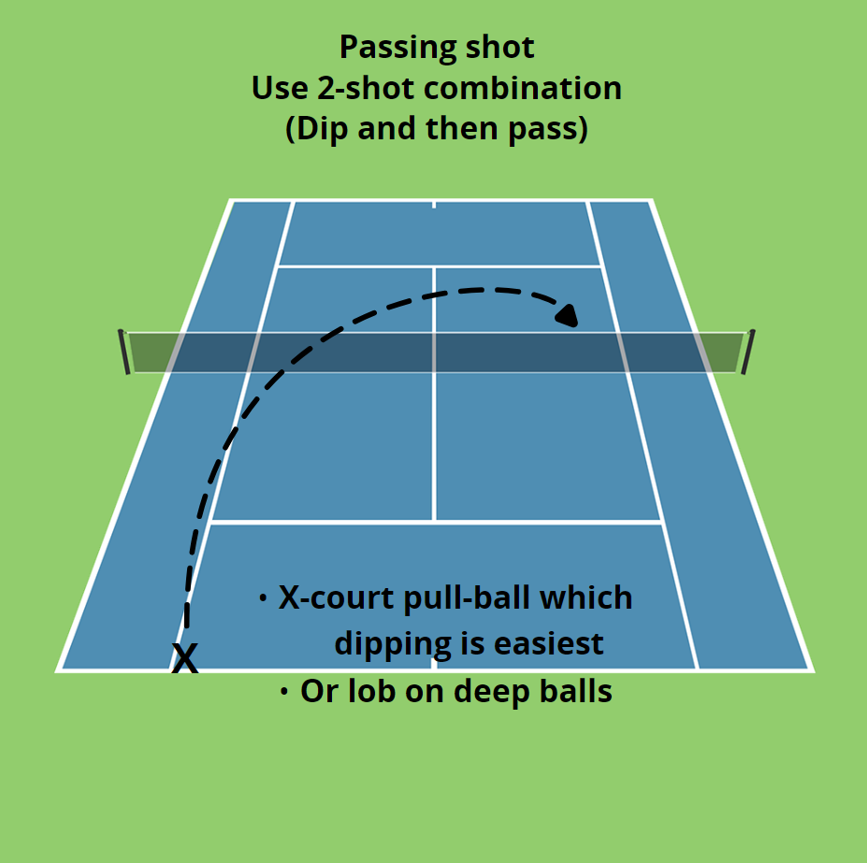

Slide 60
TEMPO
Pro players hit at almost a ball a second – you need to hit at this pace – 52-54 balls a minute. Obviously there needs to be a changeup (slice, heavy and higher sometimes)

Slide 61
Every shot during a point is either – Defensive, Neutral or Offensive
You make this decision by asking yourself:
-where are you standing on the court ?
-where your opponent is ?
-at contact -strike zone - the height of the ball in relation to the white
band - is it higher or lower / or above the shoulder?
Playing like this makes you a smarter, more consistent, winning player who understands the game and plays better % tennis.
DNO / OND

Slide 62
HOLD THE LINE
When you are wide and coming to the net – you need to hit down the line to keep the ball in front of you.

Slide 63
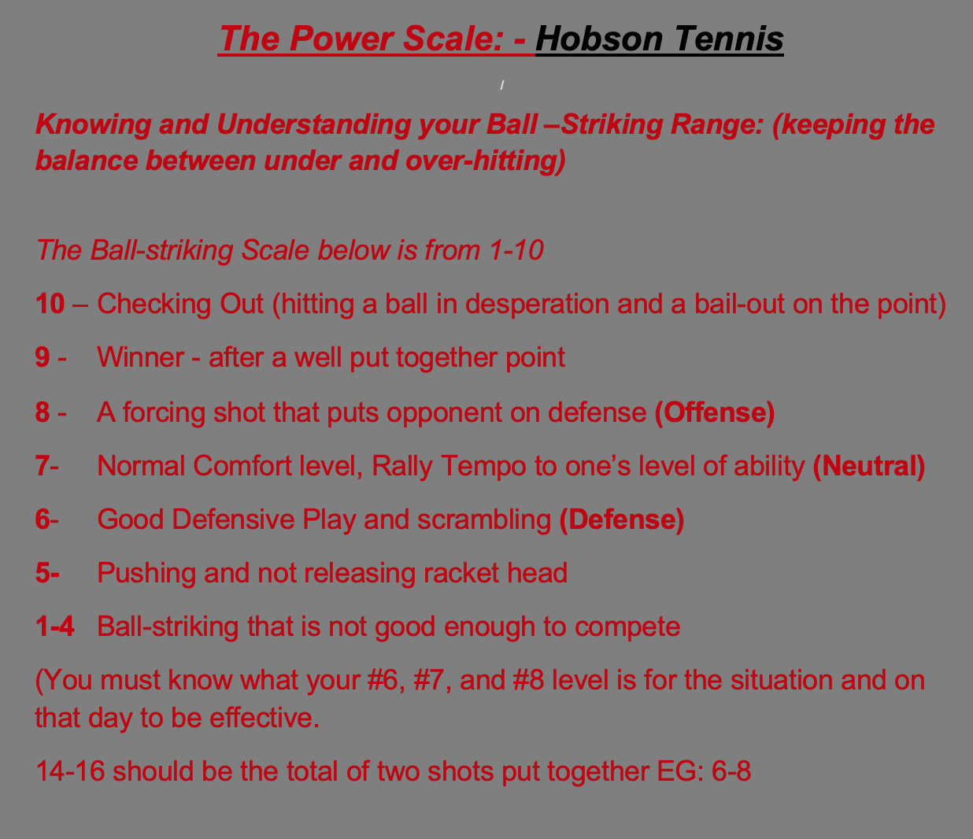

Slide 64
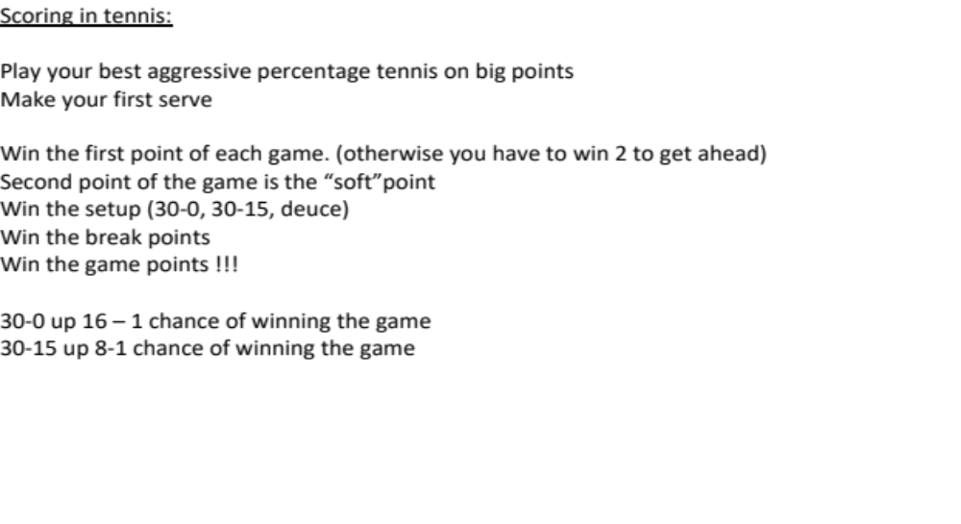

Slide 65
