Slide 1
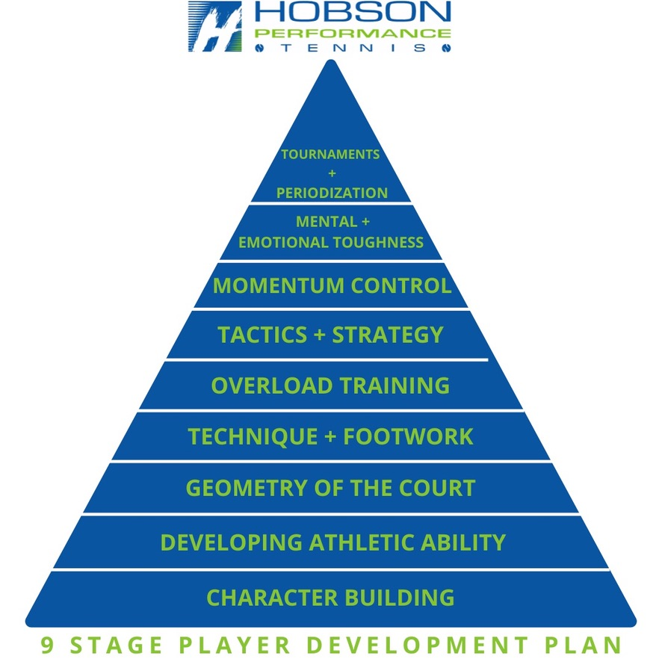

Slide 2
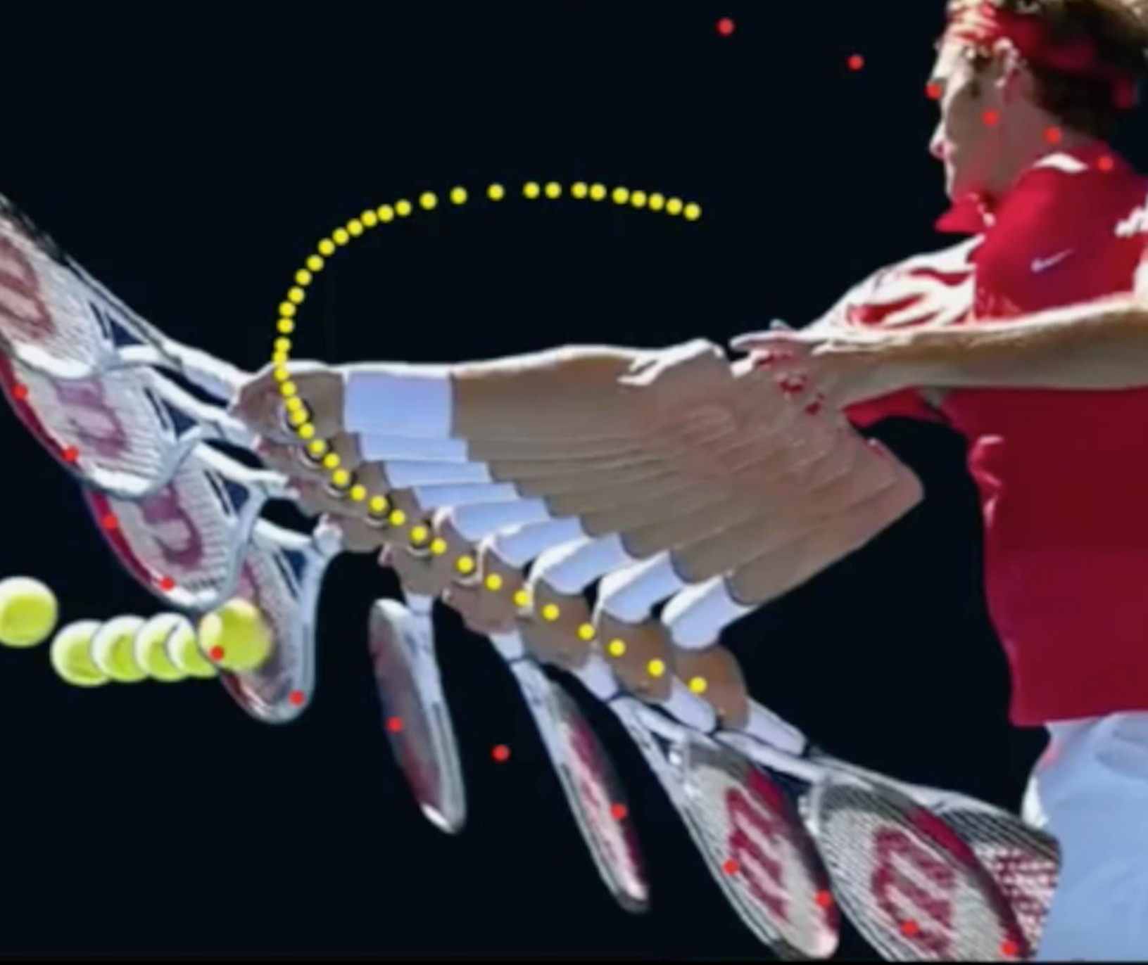
CONTACT POINT DEVELOPMENT

Slide 3
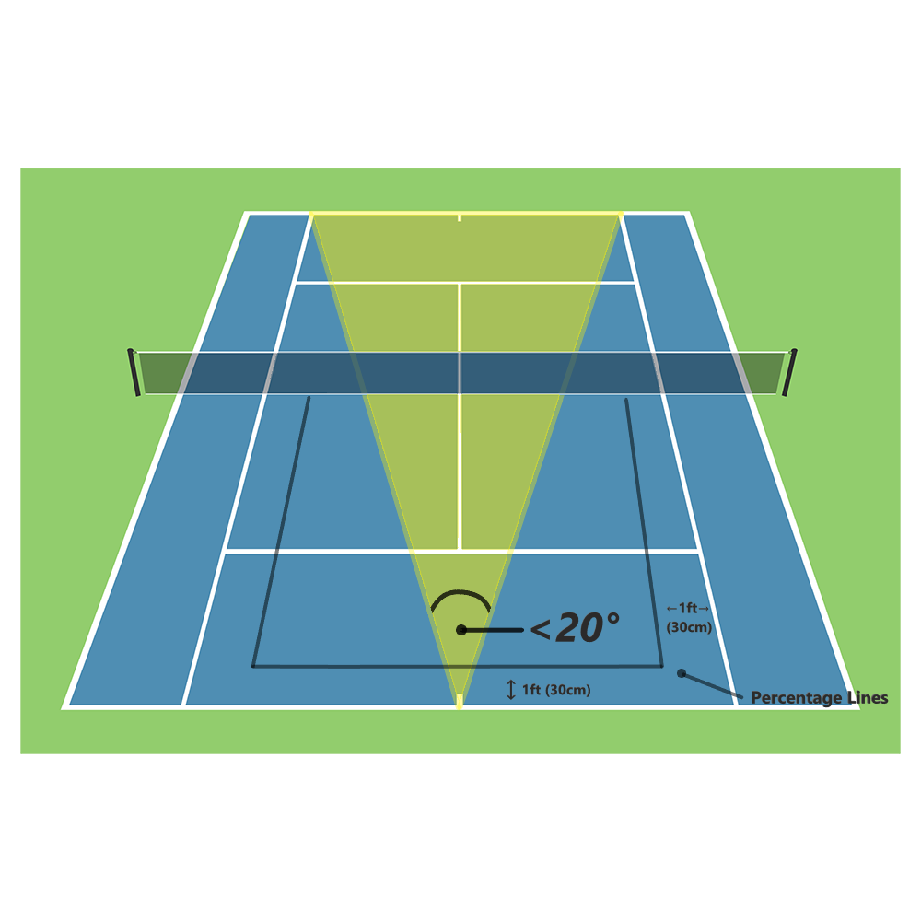
Percentage lines

Slide 4
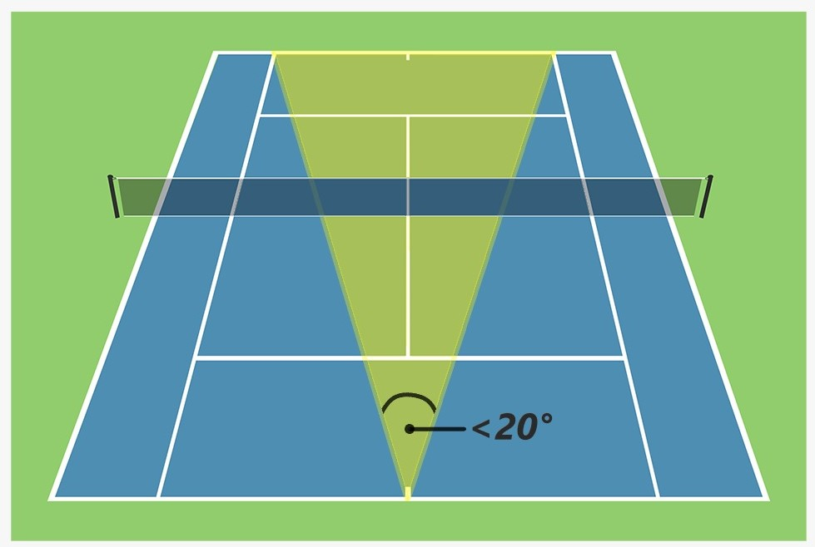
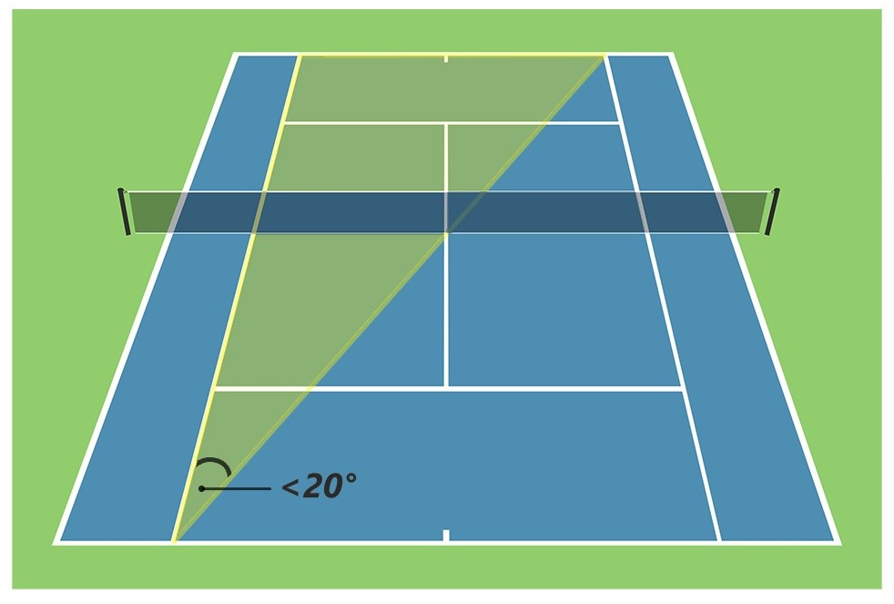
Court angle from the baseline
YOU HAVE A SMALL ANGLE TO HIT THE BALL INTO! CONTACT HAS TO BE CLEAN. LONG CONTACT ZONE AS YOU ONLY HAVE A 20 DEGREE ANGLE TO HIT THE BALL INTO. THIS IS THE REALITY OF STROKE PRODUCTION, BASED ON THE GEOMETRY OF THE COURT

Slide 5
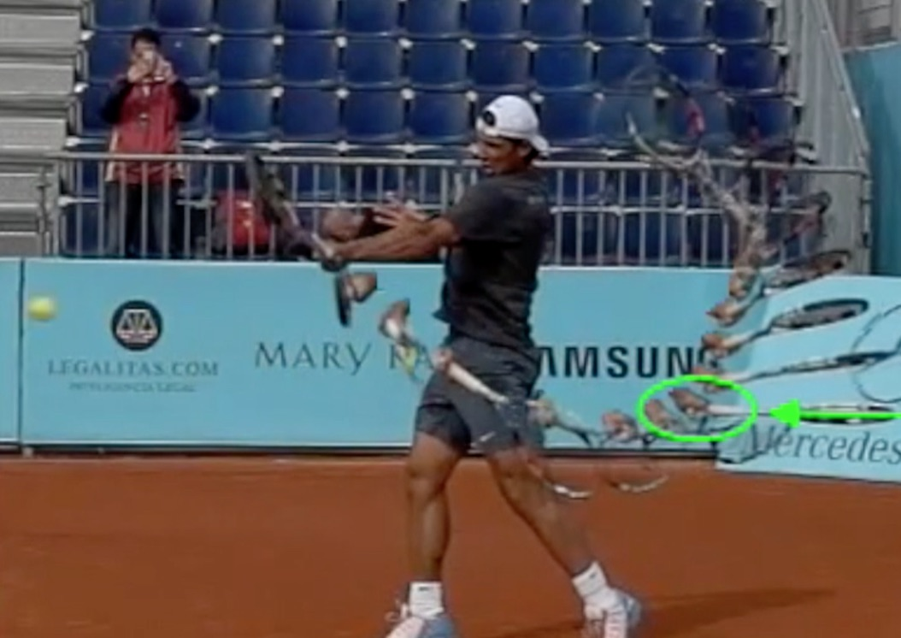
Ball has left the racket, but strings are still pushing out to target

Slide 6
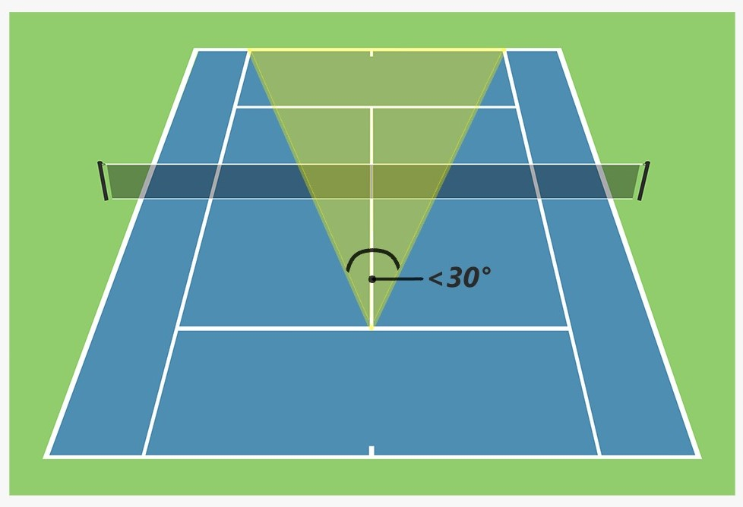
Court angle from the service line (DVP)

Slide 7
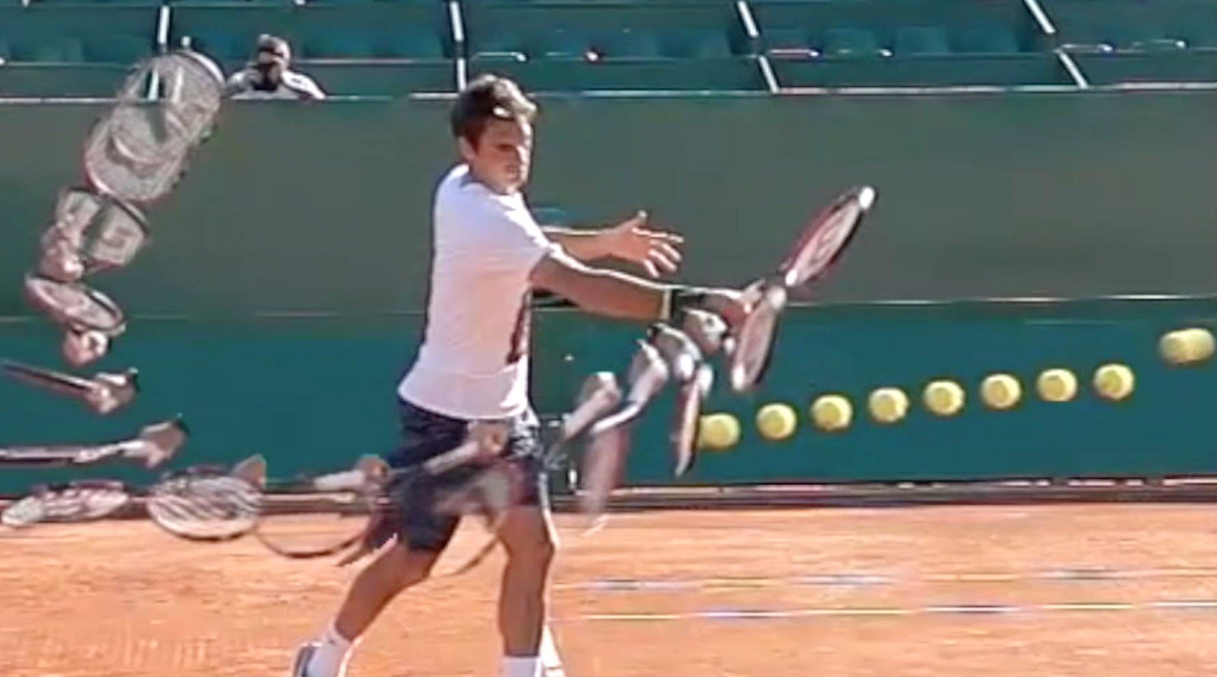

Slide 8
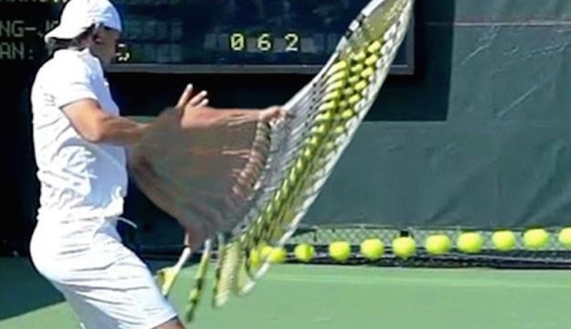

Slide 9
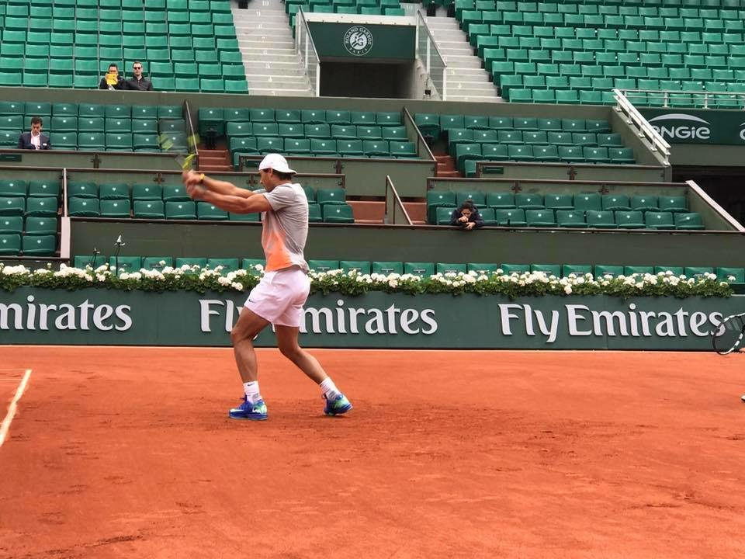
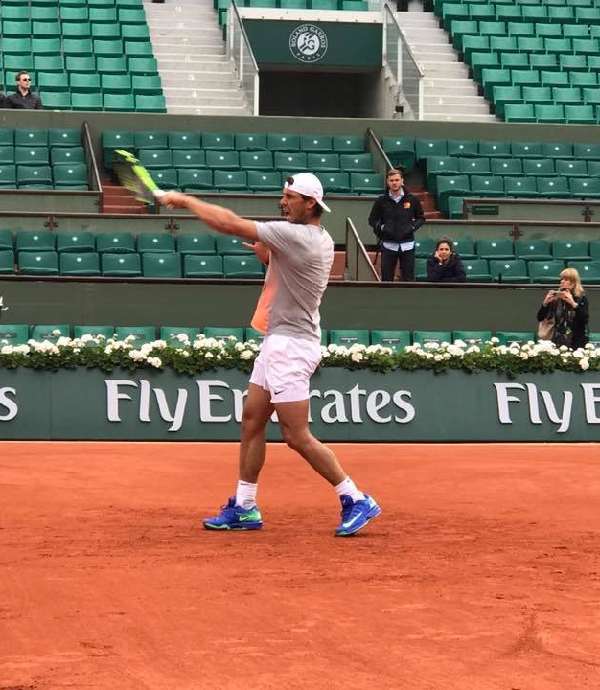

Slide 10
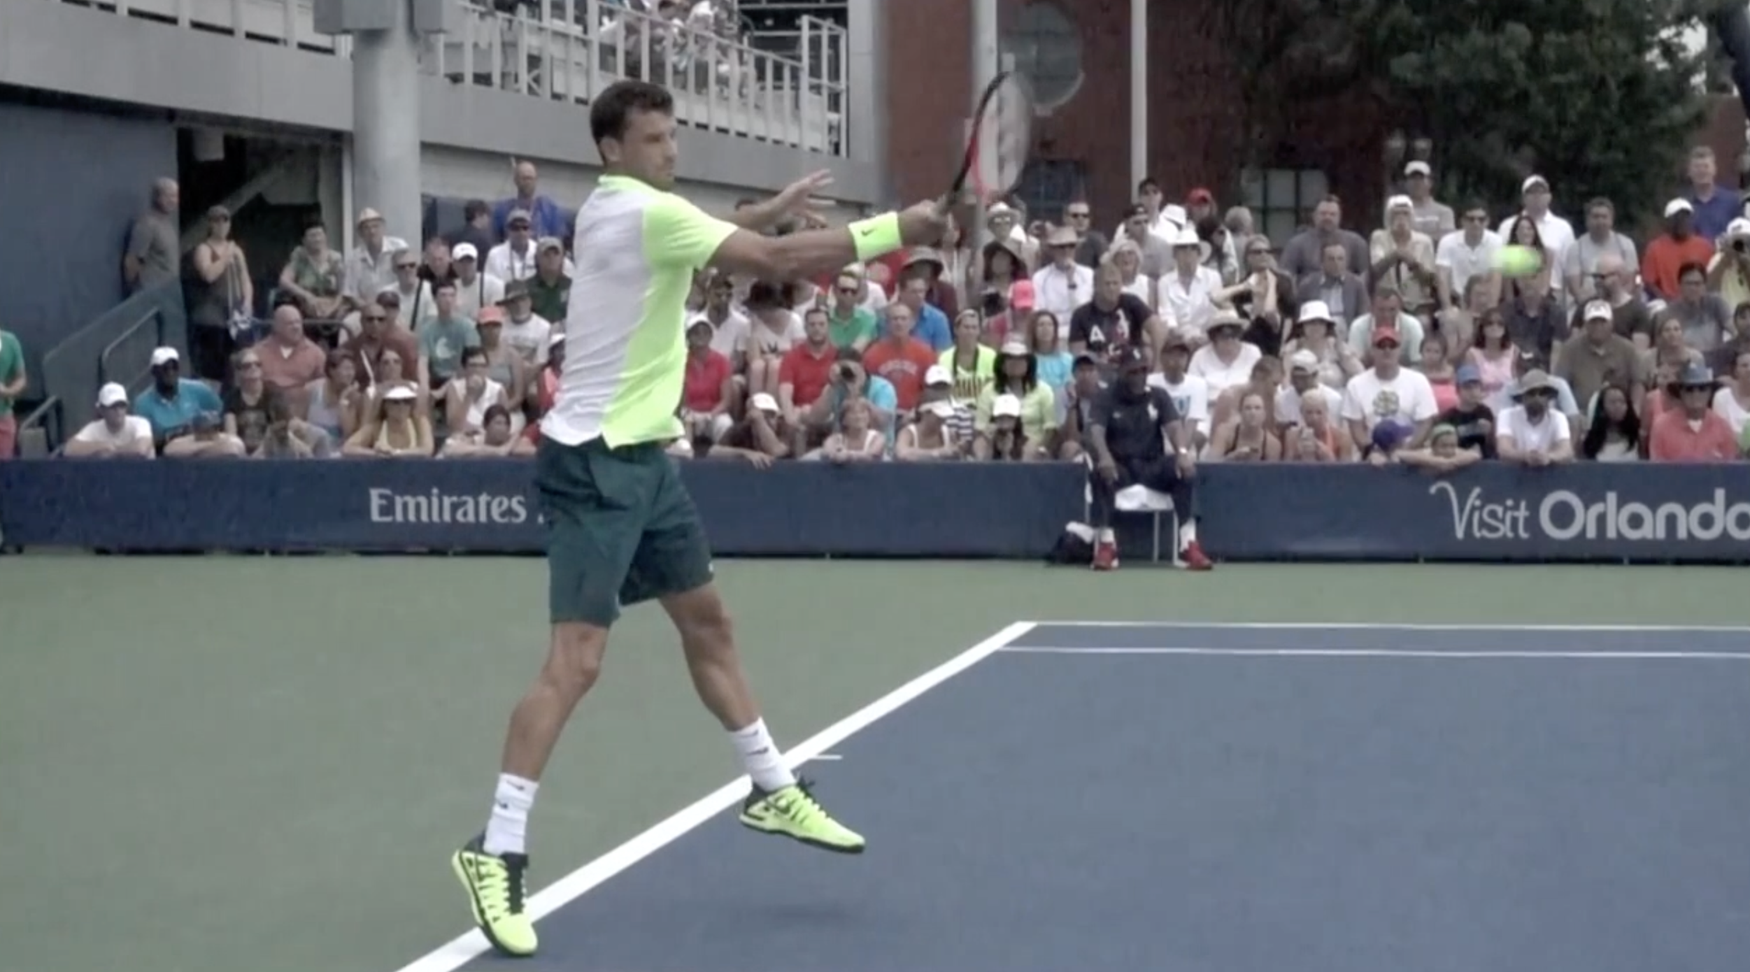

Slide 11
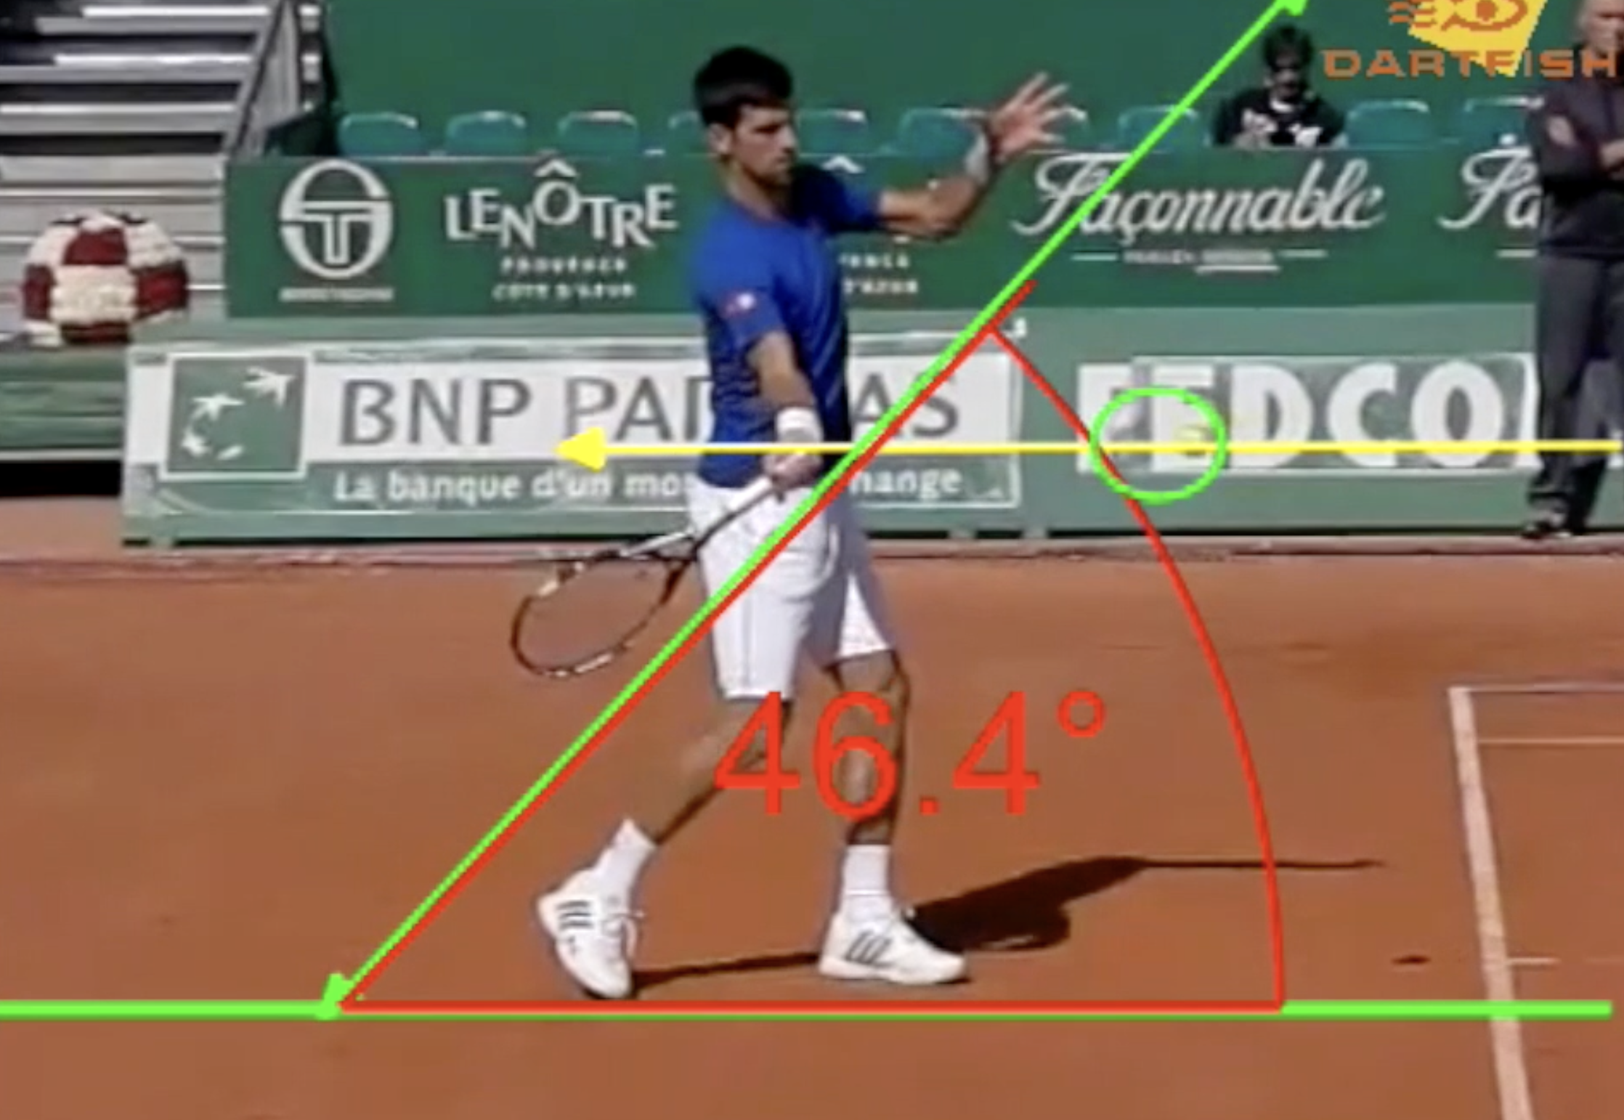
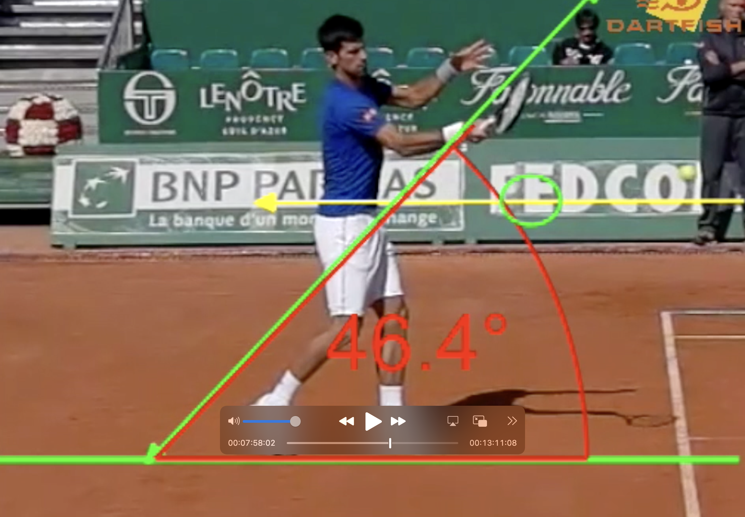

Slide 12
Drills to improve Contact
6 ball - visual
Blower cone - kinesthetic
Along fence – kinesthetic
Along net
Throw ball underhand
Med ball throws
Alley rally
Stringless racket
Pointer
Targets
Toss from behind
Finish on same side
Swing over cone
Isolate contact

